Slide 1
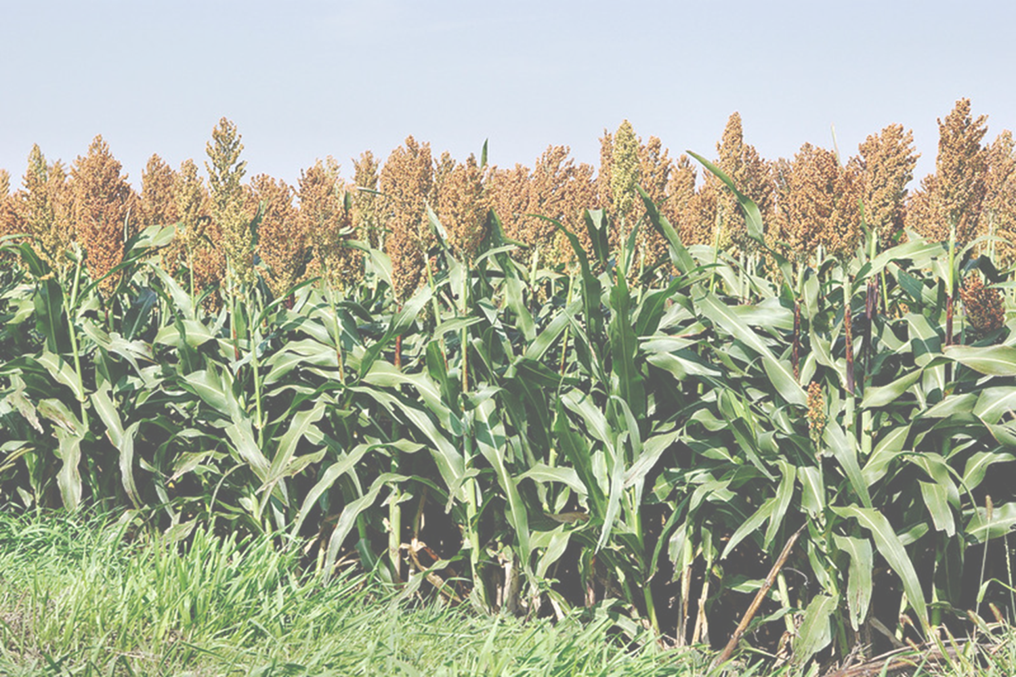
Evaluating the National Agricultural Statistics Grain Stocks Program: Results from Behavior Coding
Ashley Thompson, Heather Ridolfo,
National Agricultural Statistics Service

Slide 2
The findings and conclusions in this presentation are those of the authors and should not be construed to represent any official USDA or U.S. Government determination or policy

Slide 3
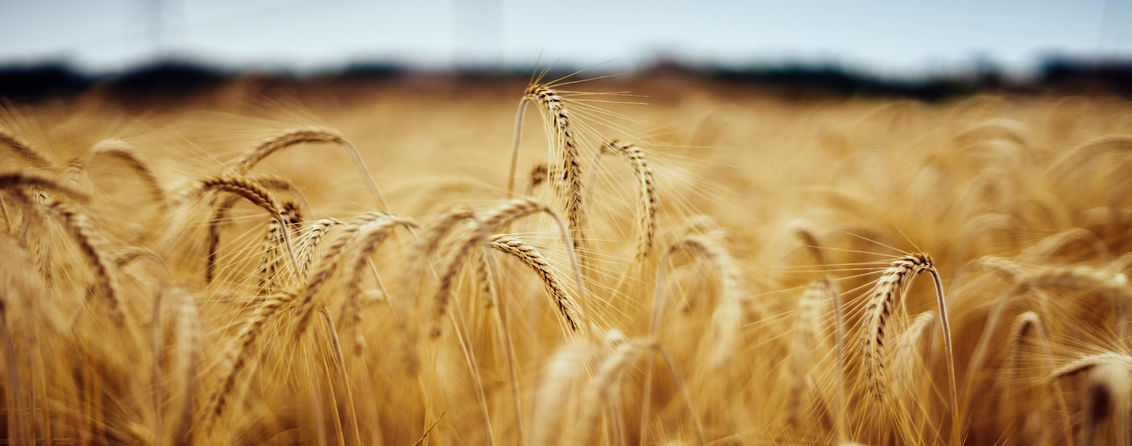
Technical Review
Top 10 strategic initiatives for 2020-2021
Questionnaire Testing Team
Design and Estimation Team

Slide 4
Conducted 4 times a year
Agricultural Survey
On farm storage capacity and stocks
Combined with Off-Farm Grain Stocks to produce estimates on storage capacity, grain and oilseeds on hand

Slide 5
Storage Capacity
On December 1, what was the TOTAL STORAGE CAPACITY of all structures normally used to store WHOLE GRAINS, PULSE CROPS or OILSEEDS on the total acres operated?
Crops Stored on This Operation
On December 1, how much WHOLE GRAIN CORN was on hand or stored on the total acres operated?
Screener Question
On December 1, were any WHOLE GRAIN CORN, SOYBEANS, SORGHUM GRAIN (MILO) WINTER WHEAT, OTHER SPRING WHEAT, BARLEY, OATS or DRY EDIBLE PEAS on hand or stored on the total acres operated?
Agricultural Survey
Cont’d

Slide 6
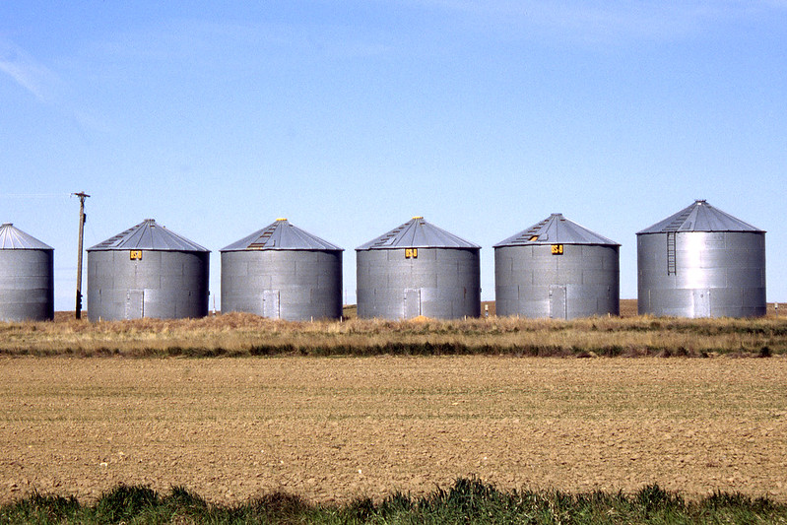
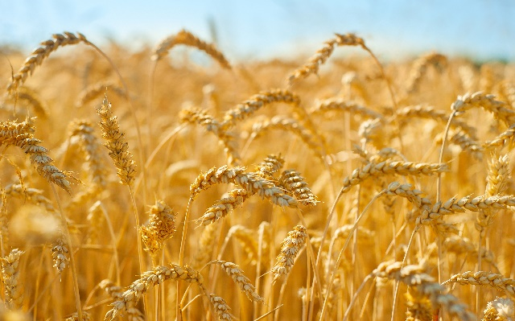
Grain Bins
Commodities

Slide 7
Behavior Coding
Codes interaction between interviewer and respondent
Questionnaire wording and administration by interviewers
Interviewer Performance

Slide 8
December 2019 Agricultural Survey
20 computer assisted telephone interviews
4 states:
North Dakota, South Dakota, Nebraska and Kansas
Methods
Questions on Storage Capacity, Crops Stored on This Operation and Unharvested Crops were coded
Screen shots from the CATI instrument were coded in the appendix

Slide 9
RESPONDENT BEHAVIORS
Coding Behaviors
INTERVIEWER BEHAVIORS

Slide 10
Interviewer Behaviors
ES Exact Wording with slight change
Interviewer read the question with slight or minimal changes
VER Verified
Interviewers verified a response that respondents preemptively provided in previous questions
MC Major Change
Interviewer changes the content of the question that could affect or could possibly affect the meaning of the question
SC Shortcutting
Interviewer entered a response without asking the question
OTH Other
Interviewer behaviors that did not fit under any response codes

Slide 11
Overall Interviewer Behavior (n=201)
46%
Major Changes
29%
Question Response Shortcutting
5%
Exact Wording/Slight Change
Table 1. Overall Interviewer Behavior (n=201)
 | Percent
Exact Wording/Slight Change | 5.47
Verified Response | 15.92
Major Change | 46.27
Question Response Shortcutting | 29.35
Other | 2.99

Slide 12
Interviewer Behavior by Question Type (n=201)
Table 2. Interviewer Behavior by Question Type (percent)
 | Interviewer Behavior
 | ES | VER | MC | SC | OTH
Storage Capacity (n=20) | 15.00 | 0.00 | 85.00 | 0.00 | 0.00
Intro Text (n=20) | 0.00 | 0.00 | 10.00 | 90.00 | 0.00
Screener (n=20) | 10.00 | 10.00 | 55.00 | 25.00 | 0.00
All Grain Stocks (n=106) | 0.00 | 13.21 | 48.11 | 33.02 | 5.66
Unharvested Screeners (n=26) | 11.54 | 50.00 | 34.62 | 3.85 | 0.00
Unharvested Acres (n=3) | 33.33 | 33.33 | 33.33 | 0.00 | 0.00
Unharvested Yield (n=3) | 33.33 | 33.33 | 33.33 | 0.00 | 0.00
Inclusion of Unharvested Production (n=3) | 33.33 | 33.33 | 33.33 | 0.00 | 0.00
Storage Capacity (n=20)
85% Major Changes
Intro Text (n=20)
90% Shortcutting
All Grain Stocks (n=106)
48% Major Changes

Slide 13
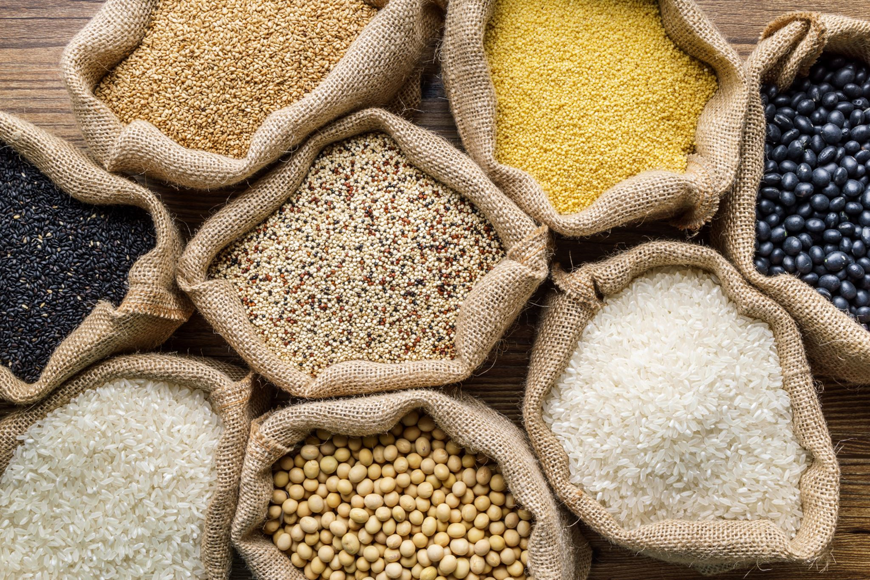
Interviewer Behavior for Crop Stocks by Commodity
Corn
64% Major Changes
21% Shortcutting
7% Verified
Soybeans
50% Major Changes
28% Shortcutting
14% Verified
Oats
38% Major Changes
46% Shortcutting
7% Verified
Table 3. Interviewer Behavior for Crop Stocks by Commodity (percent)
 | ES | VER | MC | SC | OTH
Corn (n=14) | 0.00 | 7.14 | 64.29 | 21.43 | 7.14
Soybean (n=14) | 0.00 | 14.29 | 50.00 | 28.57 | 7.14
Sorghum(n=11) | 0.00 | 18.18 | 36.36 | 36.36 | 9.09
Dry Edible Peas (n=10) | 0.00 | 20.00 | 40.00 | 40.00 | 0.00
Oats (n=13) | 0.00 | 7.69 | 38.46 | 46.15 | 7.69

Slide 14
Storage Capacity
85% Major changes to storage capacity questions
70% administrations left out reference date
55% interviewers left out phrases
On December 1, what was the TOTAL STORAGE CAPACITY of all structures normally used to store WHOLE GRAINS, PULSE CROPS OR OILSEEDS on the total acres operated?

Slide 15
Storage Capacity
Interviewer: Storage facilities. Do you have any?
Respondent: Yeah
Interviewer: Okay. What’s their capacity?
Respondent: uh..gosh..uh about 47,000 bushels
Interviewer: 47,000 bushels?
Respondent: Yeah, total
On December 1, what was the TOTAL STORAGE CAPACITY of all structures normally used to store WHOLE GRAINS, PULSE CROPS OR OILSEEDS on the total acres operated?

Slide 16
Introductory Text
Please account for any WHOLE GRAINS, CORN, SOYBEANS, SORGHUM GRAIN (MILO), WINTER WHEAT, OTHER SPRING WHEAT, BARLEY OATS, or DRY EDIBLE PEAS stored December 1 on this operation, whether for feed, seed or sale. They may have belonged to you or someone else or been stored under a government program (loan, farmer owned reserve or CCC)
[ENUM] Include all whole grain on the ground or in temporary storage on the acres operated.
90% of respondents were not read the introductory text

Slide 17
Crops Storage Screener
10% of administrations are as worded
55% major changes to crops storage screener question
50% of administrations left out phrase
“on total acres operated”
On December 1, were any WHOLE GRAINS, SOYBEANS, SORGHUM GRAIN (MILO), WINTER WHEAT, OTHER SPRING WHEAT, BARLEY, OATS, or DRY EDIBLE PEAS on hand or stored on the total acres operated?

Slide 18
Corn, Sorghum, Wheat, Winter Wheat, Durum, Spring Wheat, Barley, Oats
48% major changes to crop storage questions
33% of questions were not asked or interviews did not verify the information
Crop Storage
On December 1, how much WHOLE GRAIN CORN was on hand or stored on the total acres operated?

Slide 19
Crops Storage
Interviewer: Do you have soybeans still in storage?
Respondent: No. Well, we do and we don’t… they are still in commercial storage I guess.
Interviewer: Alright.
On December 1, how many SOYBEANS were on hand or stored on the total acres operated?

Slide 20
Respondent Behaviors
CA
Codable Answer
Responses that are plausible and matched format of the response options
QA
Qualified Answer
Respondent provides a suitable answer
CLAR
Request for clarification
Interviewer behaviors that did not fit under any response codes
VERCORR
Respondent Corrects the verification
Responses were not given in the format of the response options
INTRO
Answered Intro Test
Respondent attempts to provide a response to introductory text
INC
Response not in intended format
Responses were not given in the format of the response options
VERNORES
Respondent does not respond to verification
Respondent provides no response to follow up questions
REF
Refusal
Respondent refuses to answer the question from the interviewer

Slide 21
Overall Respondent Behavior (n=142)
Table 5. Overall Respondent Behavior (n=142)
 | First Exchange | Final Exchange
 | Percent | Percent
Codable Answer (n=73) | 51.41 | 61.97
Incorrect Format (n=45) | 31.69 | 21.38
Qualified Answer (n=5) | 3.52 | 4.23
Asked for Clarification (n=4) | 2.82 | 0.00
Responded to Intro Text (n=2) | 1.41 | 1.41
Interrupted Interviewer (n=0) | 0.00 | 0.00
Did Not Respond to Verification (n=2) | 1.41 | 2.82
Corrected Verification (n=5) | 3.52 | 2.11
“Don’t know” Response (n=0) | 0.00 | 0.00
Refusal (n=6) | 4.23 | 5.63
Not Applicable (n=0) | 0.00 | 0.00
61%
Codable Answers (n=73)
21%
Incorrect Format (n=45)
2%
Corrected Verification (n=5)

Slide 22
Current Capacity is different form capacity reported in the previous survey.
Sum of grain stored exceeds current capacity
Current stocks are greater than stocks reported in previous survey
Current stocks are greater than 150% of production
Current stocks are greater than previous stocks and unharvested production
Yield for unharvested crops seem too high
Edit Warnings

Slide 23
Modifications to the CATI instrument
Format edit warnings
Recommendations
Training to focus on reading questions as worded
Revise introductory text

Slide 24
Thank you!!

