Slide 1
Usability Evaluation of Smartphone-based Data Collection Instrument Lin Wang¹, Shelley Feuer¹, Heather Ridolfo², Alda Rivas¹, Anthony Schulzetenberg³ ¹ U.S. Census Bureau ² USDA NASS (now with U.S. Energy Information Administration) ³ U.S. Census Bureau (now with LexisNexis) 2021 FCSM November 4, 2021
Disclaimer: The findings and conclusions in this presentation are those of the authors and should not be construed to represent any official USDA, DOC, DOE or U.S. Government determination or policy. The use of product, brand, or corporation names in this presentation is for information purposes only. The use does not constitute endorsement by the USDA, DOC, or DOE.

Slide 2
Outline
The data collection instrument - FoodLogger
Study design of the usability evaluation
Major findings from the usability evaluation
Notes:
The talk consists of three parts:
High-level description of the data collection instrument, called FoodLogger
Then, I will go through the study design …
Lastly, I will present some major findings from the evaluation

Slide 3
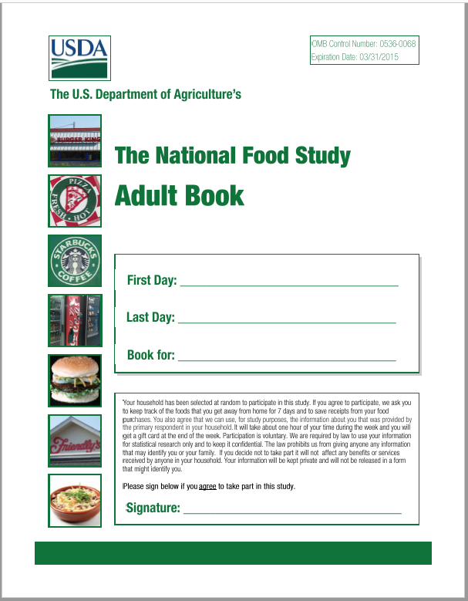
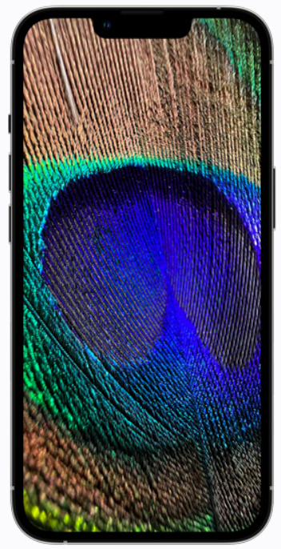
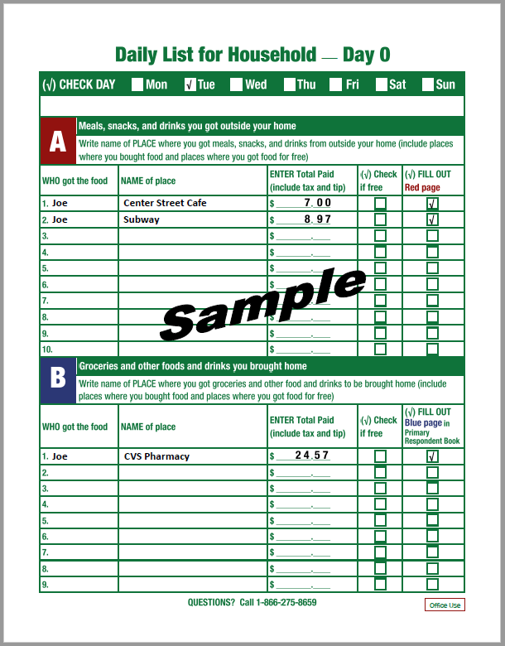
FoodLogger – Diary Survey on Smartphone
Notes:
First, what is FoodLogger?

Slide 4
FoodLogger Design Concepts
DAY
Day 1
Day 2
Day 3
Day 4
Day 5
Day 6
Day 7
STOP
Stop 1
Stop 2
Stop 3
Stop 4
Stop 5
FOOD EVENT
Food Event 1
Food Event 2
Food Event 3
FOOD ITEM
Food Item 2
Food Item 3
Food Item 1
Food Item 4
Notes:
Data collection period -> seven days.
Respondent’s state: in motion or in stop
Food acquisition can take place only in stop.
1 food acquisition = a food event
A food event = aggregation of food items

Slide 5
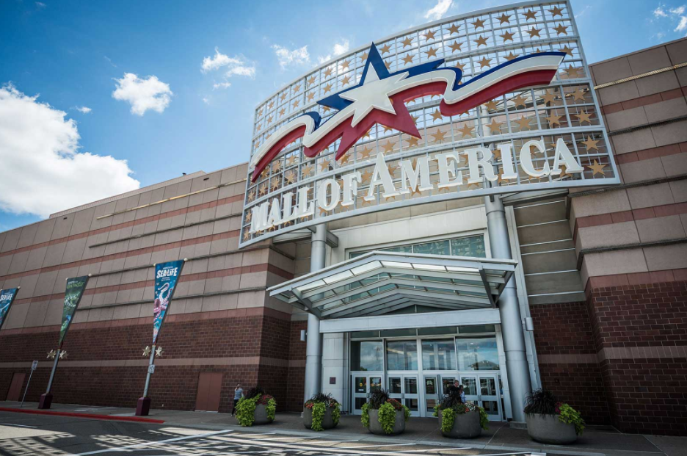
FoodLogger Design Concepts
DAY
Day 1
Day 2
Day 3
Day 4
Day 5
Day 6
Day 7
STOP
Stop 1
Stop 2
Stop 3
Stop 4
Stop 5
Notes:
Data collection period -> seven days.
Respondent’s state: in motion or in stop
Food acquisition can take place only in stop.
1 food acquisition = a food event
A food event = aggregation of food items

Slide 6
FoodLogger Design Concepts
DAY
Day 1
Day 2
Day 3
Day 4
Day 5
Day 6
Day 7
STOP
Stop 1
Stop 2
Stop 3
Stop 4
Stop 5
FOOD EVENT
Food Event 1
Food Event 2
Food Event 3
Notes:
Data collection period -> seven days.
Respondent’s state: in motion or in stop
Food acquisition can take place only in stop.
1 food acquisition = a food event
A food event = aggregation of food items

Slide 7
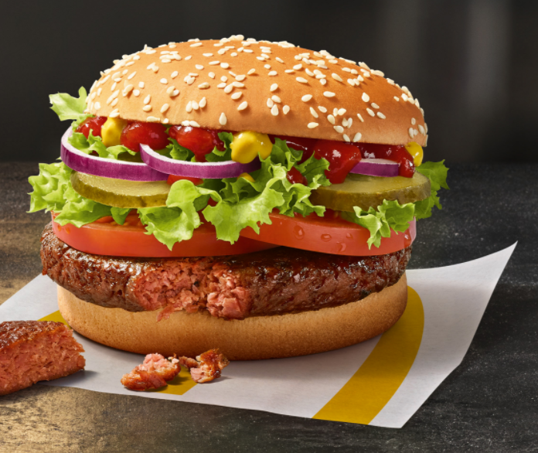
FoodLogger Design Concepts
DAY
Day 1
Day 2
Day 3
Day 4
Day 5
Day 6
Day 7
STOP
Stop 1
Stop 2
Stop 3
Stop 4
Stop 5
FOOD EVENT
Food Event 1
Food Event 2
Food Event 3
FOOD ITEM
Food Item 2
Food Item 3
Food Item 1
Food Item 4
Notes:
Data collection period -> seven days.
Respondent’s state: in motion or in stop
Food acquisition can take place only in stop.
1 food acquisition = a food event
A food event = aggregation of food items

Slide 8
Data Entry Workflow
Notes:
Schematic diagram of data entry workflow.

Slide 9
Usability Evaluation Objectives
Effectiveness - success of data entry, accuracy of entered data
measurement errors
Efficiency - time taken to enter data
respondent burden
Satisfaction – self-reported experience of using the instrument
drop out
Notes:
Access three aspects: Effectiveness, efficiency, and satisfaction
It hoped that successfully entering data with accuracy would reduce measurement errors
Shorter time of entering data help reduce respondent burden
Better satisfaction with using FoodLogger would keep R being engaged with data reporting throughout 7 days

Slide 10
Usability Evaluation Strategies
Specific aim - identifying usability issues and discovering their causes
Iterative testing – 1st round of testing -> modifying instrument -> 2nd round of testing -> modifying instrument
Combination of lab-based testing and 7-day field observation - assessing participants’ performance of critical tasks as well as continuation of using FoodLogger
Qualitative methods – observation and retrospective probing, quantitative analyses performed as possible
Remote testing - due to COVID-19 pandemic
Notes:
We primarily used qualitative methods for the evaluation

Slide 11
Usability Evaluation Methods (I)
Participating households (HH)
Round-1: 6 HHs (2 aged 60+, 5 receiving SNAP/WIC, 3 having children of <11 years old, 2 having children of 11-15 years old)
Round-2: 5 HHs (2 aged 60+, 3 receiving SNAP/WIC, 3 having children of 11-15 years old)
Evaluation framework
FoodLogger installation
Data entry training
7-day field test
Lab-based usability testing
Notes:
The evaluation consists of four components:
We will focus on the lab-based usability testing.

Slide 12
Usability Evaluation Methods (I)
Evaluation procedure
Component | Day 1 | Day 2 | Day 3 | Day 4 | Day 5 | Day 6 | Day 7 | Day 8
Being introduced to the study | x
Receiving a Disclaimer | x
Signing a Consent Form | x
Completing a demographic questionnaire | x
Installing FoodLogger | x
Data entry training | x
Field data entry | x | x | x | x | x | x | x
Lab-based usability testing |  | Round 2 |  | Round 1
Field data entry debriefing |  |  |  |  |  |  |  | x
Signing incentive voucher |  |  |  |  |  |  |  | x
Notes:
We will focus on the lab-based usability testing.

Slide 13
Usability Evaluation Methods (II - Lab)
Task analysis
22 critical tasks (e.g., Start a day, Add a stop, Add a food event, Enter food item name, Enter weight/volume/size, Enter payment)
Food Event Type
A Food-at-home (FAH) event
A Food-away-from-home (FAFH) event
Use Cases
Grocery shopping (FAH + FAFH)
Online meal order (FAFH)
School meal (FAFH)
Notes:
A critical task refers to a task such that failure to complete it will result in measurement errors
5. In terms of where the food is usually consumed.

Slide 14
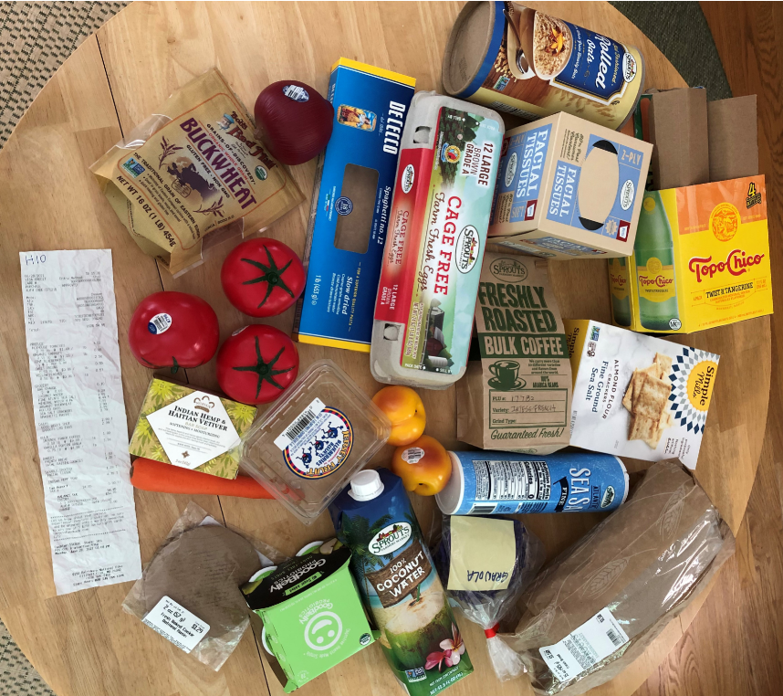
Use Case of Grocery Shopping
Scenario:
Grocery shopping, including a lunch meal that was eaten on the spot
Critical tasks:
Start a day
Select a food stop from a list of stops identified by the online map
Select a food event
Enter food item name (Text, Barcode, PLU)
Enter weight/volume/piece
Enter number of items (quantity)
Enter payment information (Pay by single mode, Pay by multiple modes)

Slide 15
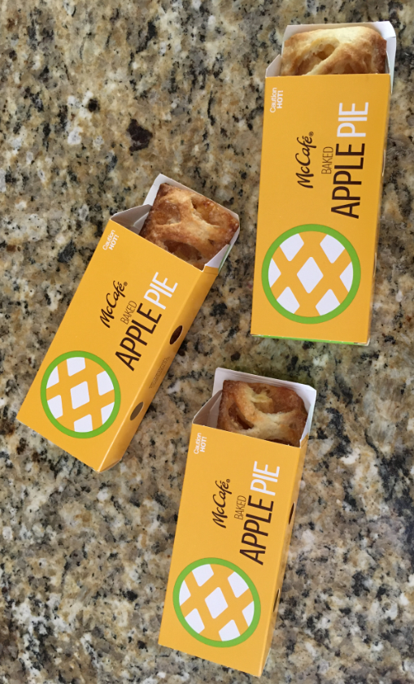
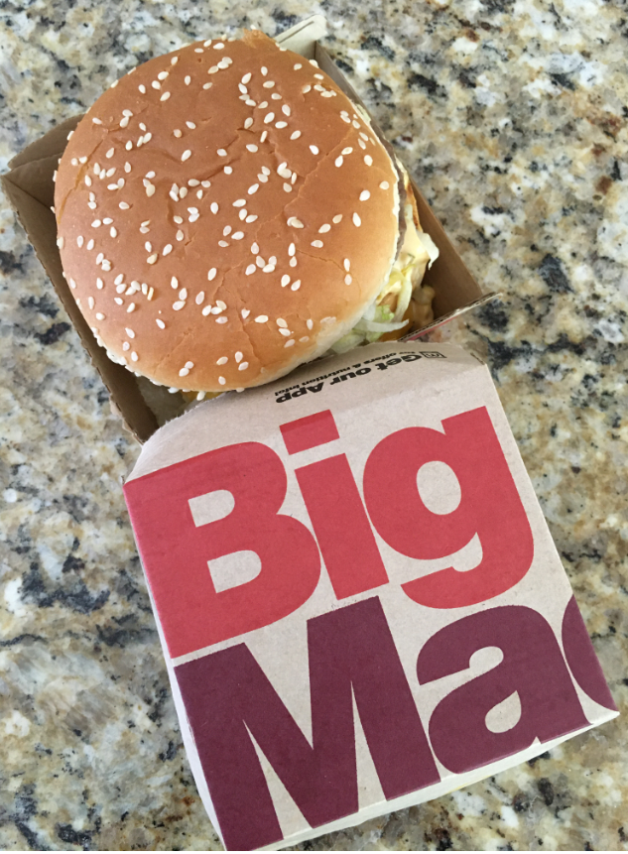
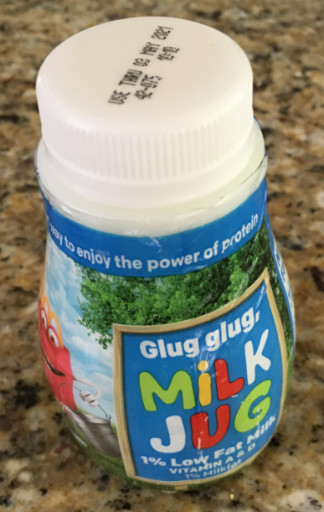
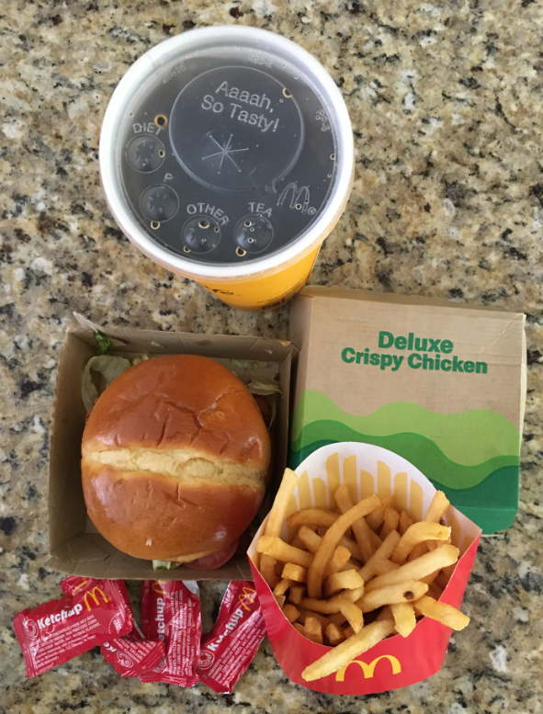
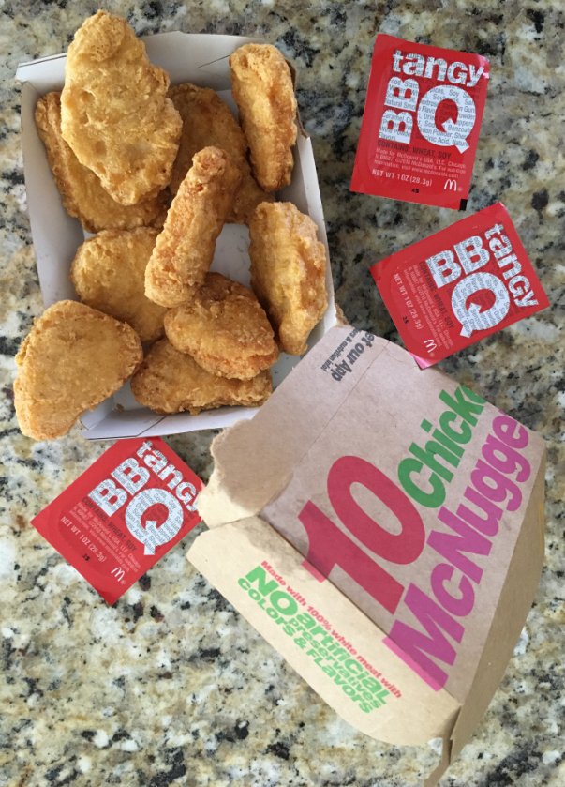
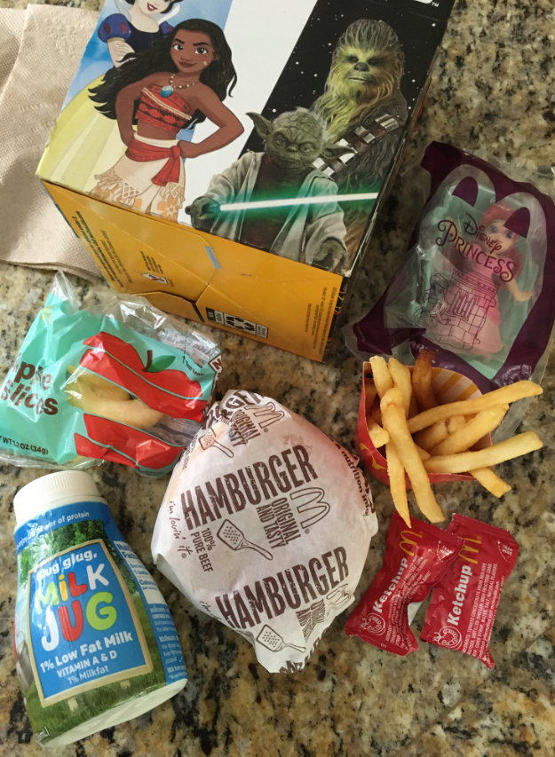
Use Case of Online Meal Order
Scenario:
Online order of home-delivery meal from McDonald’s
Critical tasks:
Start a day
Select a food stop from a list of stops identified by the online map
Add a food event manually
Enter "combo meal" information
Select "individual item" button
Enter meal name
Enter meal price
Enter number of items (quantity)
Enter individual meal items
Enter total event cost or price
Select payment type
Upload an electronic receipt

Slide 16
Use Case of School Meal
Scenario:
A school lunch that was eaten at the school cafeteria
Critical tasks:
Start a day
Add a food stop to FoodLogger in the text field
Add a food event manually
Select "combo meal" button
Enter meal name
Enter meal price
Enter individual meal items
“Other” option (those that do not conform to pre-defined list of combo items)
Enter payment type
Food items:
A carton of milk
Mashed potatoes
Gravy
One slice of beef
A side of corn
Four scenarios:
Not Free – Proxy Report
Free – Proxy Report
Not Free – Self Report
Free – Self Report
Notes:
In essence, HAFH
Four scenarios depending on how the meal is paid and who is reporting.

Slide 17
Major Findings – Lab-based Testing (I)
10 out of 11 adult participants completed assigned tasks.
Average time taken to enter information about one food item was around 2 minutes.
Paper receipts could be photoed and uploaded with ease in < 1 minute.
6 out of 10 adult participants missed reporting the lunch meal in the grocery shopping use case.
Optimal food name entry rate = (number of food items entered into FoodLogger using optimal name entry method) / (number of total food items entered into FoodLogger )
Round 1 – Mean: 0.69, Range: 0.17-1.0
Round 2 – Mean: 0.9, Range: 0.5-1.0
Notes:
Food name entry: text, barcode, PLU = Price Look-Up code

Slide 18
Major Findings – Lab-based Testing (II)
Optimal packaging selection rate = (Number of food items entered into FoodLogger with optimal packaging selection) / (number of total food items entered into FoodLogger)
Round 1 – Mean: 0.9, Range: 0.69-1.0
Round 2 - Mean: 0.95, Range: 0.85-1.0
Optimal weight/volume selection rate = (Number of food items entered into FoodLogger with optimal weight/volume selection) / (Number of total food items entered into FoodLogger)
Round 1 – Mean: 0.83, Range: 0.72-1.0
Round 2 – Mean: 0.87, Range: 0.71-1.0
8 out of 11 adult participants had difficulty of uploading an electronic receipt.

Slide 19
Major Findings – 7-Day Data Entry
 | Extremely easy | Easy | Neutral | Difficult | Extremely difficult
Confirming a Stop | 9 | 1
Manually adding a Stop | 5 | 4 | 1
Adding a Food Event | 8 | 1 | 1
Scanning a barcode | 5 | 3 | 2 | 1
Entering a PLU | 9 | 1
Entering a food item name | 6 | 3 | 1
Entering size/weight/volume | 3 | 2 | 4 | 1
Entering cost for a food item | 7 | 2 |  | 1
Entering cost for entire food event | 9 | 1
Choosing method of payment | 10
Notes:
Responses to a briefing questions.
Consistency in results pattern between lab and field.

Slide 20
Major Findings – Crucial Usability Issues
Barcode scanning / PLU entry – Lack of a graceful exit from a failure of database lookup.
Weight/volume/piece data entry – Errors resulted from inadequate packaging selection.
Electronic receipt uploading – A complex task

Slide 21
Summary
A systematic approach to evaluating a complex survey instrument: Understand the workflow, identify critical tasks, design use cases, integrate lab-based test with field observation.
Iterative usability testing with in-time feedback.
Close collaboration with survey sponsor and instrument developer.

Slide 22
Contact
lin.wang@census.gov

