Slide 1
Estimation of Deaths among Health Care Personnel with COVID-19 using Capture-Recapture Methods
United States, March 17 – April 29, 2020
Jennifer Rammon (NCHS), Kerui Xu, Matthew Stuckey, Michelle Hughes, Reid Harvey, Sherry Burrer, Sophia Chiu, Jess Rinsky, Matthew Groenewold (researchers and deployers from CDC/Atlanta )
2021 Federal Committee on Statistical Methodology Research and Policy Conference
November 3rd, 2021
Notes:
Good morning. Thank you for listening to my presentation today. The title of our project is “Estimation of Deaths among Health Care Personnel with COVID-19 using Capture-Recapture Methods in the United States from March 17 through April 29, 2020.
I work at the National Center for Health Statistics in the Division of Research and Methodology and am collaborating on this work with several researchers from CDC/Atlanta.

Slide 2
Background

Slide 3

Background: Health Care Personnel
doi:10.7326/M20-1874
Notes:
Healthcare personnel (HCP) are essential workers at risk for severe acute respiratory syndrome coronavirus 2 (SARS-CoV-2) infection and COVID-19 disease, and can be exposed in the workplace, at home, and in the community.”
In addition to the high risk associated with occupational exposure, it has been estimated that 26.6%, or approximately 3.7 of the nation’s 13.8 million U.S. health care personnel with patient contact have an elevated risk of developing severe COVID-19 due to age, chronic lung disease, moderate or severe asthma, morbid obesity, diabetes, or liver disease.
National surveillance is necessary for monitoring and understanding the impact of the pandemic on this population in the United States.

Slide 4

Background
Health care personnel status available in
- 16% of cases as of April 2020
- 22% of cases as of July 2020
- 18% of cases as of October 2021
https://covid.cdc.gov/covid-data-tracker/#health-care-personnel.
CDC
Health Care Personnel: ?
Standardized Case Report Form
Notes:
Since January 21, 2020, state and territorial jurisdictions have reported patient-level case reports to CDC for a subset of COVID-19 cases using a standardized case report form (CRF). When submitting COVID-19 case reports, jurisdictions may identify whether individuals are or are not health care personnel. The completion of health care personnel status (Yes or No) in patient-level case data varied across and within jurisdictions over time; some jurisdictions are unable to provide health care personnel status in their case reports. According to CDC’s COVID-19 data tracker health care personnel status was available in 16% of cases as of April, 2020, 22% of cases as of July 2020, and 18% of cases as of October 2021. As a result, there has been limited information available on the number of COVID-19 deaths among health care personnel and throughout the pandemic, there has not been a single source that captures timely data on all COVID-19-associated deaths among health care personnel. The number of deaths in this population has been largely underreported and under detected.

Slide 5

Crowdsourcing and Web-scraping Efforts
https://khn.org/news/tag/lost-on-the-frontline/
https://www.theguardian.com/us-news/ng-interactive/2020/dec/22/lost-on-the-frontline-our-findings-to-date
Notes:
There have been several reports that have used crowdsourcing and web-scraping techniques to estimate the number of health care personnel deaths caused by COVID-19. These are extremely valuable. Their limitation, is that, as they acknowledge, they are likely biased downward and likely underestimate the true value.
The most exhaustive effort, covered by many media sources and produced as a partnership between the Guardian and Kaiser Health News, is an interactive, public-facing database entitled “Lost on the Frontline”. It aims to count and honor every US healthcare worker who died in the first year of the pandemic. We note that the Guardian project does not do exposure investigations for all health care personnel to determine if they contracted COVID-19 on the job or elsewhere.
Other early estimates based on crowdsourcing were published by Amnesty International, BMJ Global Health, and Occupational Medicine.
Additionally, the Centers for Medicare and Medicaid Services (CMS), the American Association for Retired Persons (AARP), and others have produced estimates of death rates among nurses and nurses in nursing care facilities. In fact, CMS required that all certified skilled nursing facilities report all staff deaths beginning in June 2020 via CDC’s National Healthcare Safety Network. However, the NHSN mechanism wasn’t available in March and April 2020.

Slide 6
Objective

Slide 7

Objective
Web Scraping
Health Care Personnel: ???
Standardized Case Report Form
Notes:
Our purpose is to address this problem by using information from multiple sources to provide a fuller picture of HCP mortality at the national level.

Slide 8


Capture-Recapture or Dual Source Estimation
March 17th — April 29th, 2020
Web Scraping
Health Care Personnel: ???
Standardized Case
Report Form
getblogo.com
Notes:
Specifically, we aim to estimate the number of deaths among health care personnel with COVID-19 nationwide during March and April, 2020 using capture-recapture methods. We match data on deaths among health care personnel collected by CDC’s case report forms with media reports identified by web-scraping techniques.
The dates coincide with the dates that CDC deployers were involved in web scraping operations as a means of COVID-19 surveillance and outbreak detection. As case volume and community transmission increased, the media were publishing fewer articles on individual HCP deaths and activities transitioned to a different phase after the spring of 2020.
In a broad sense, this study is meant to serve as a useful guide for conducting mortality surveillance in a pandemic response. Our findings help to evaluate the utility and limitations of a dual-record system approach: joining incomplete data from different sources to estimate total deaths during large-scale emergencies.

Slide 9

Objective
Robustness of the Chapman estimator
Violations to assumptions
Sensitivity analyses
Comparisons to other published estimates
Notes:
For this presentation, I will focus on the robustness of the Chapman estimator and explore the effects of possible violations to the assumptions implicit in the capture-recapture approach. In order to conduct sensitivity analyses, I present three methodological approaches for estimation and compare the results, then compare our estimates to other published estimates.

Slide 10
Methods

Slide 11
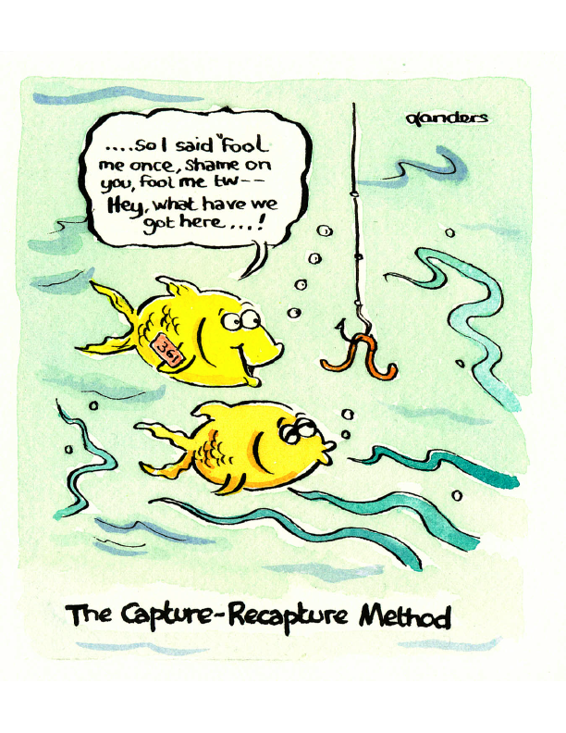
Capture-Recapture Methods
Dual-source methods or multiple systems estimation
Useful approach for estimating an unknown population size using multiple samples/sources
First developed by ecologists
Now a key approach for quantifying hidden populations (e.g., number of victims of modern slavery, number of casualties in armed conflicts, number of injecting drug users)
HRDAG: Human Rights Data Analysis Group
CAUSEweb
Notes:
Capture-recapture methods or dual source methods are a useful approach for estimating an unknown population size by using multiple samples and comparing multiple sources of epidemiological data.
This methodology was first developed by ecologists for the studies of animal abundance, in which an estimate of a species’ population size is calculated after the species are captured, tagged and recaptured.
More currently, this is a key approach used to quantify hidden populations, such as the number of victims of modern slavery, the number of casualties in armed conflicts, or the number of injecting drug users.
A good resource for reading more about some of the recent research in this field is HRDAG: The Human Rights Data Analysis Group.

Slide 12

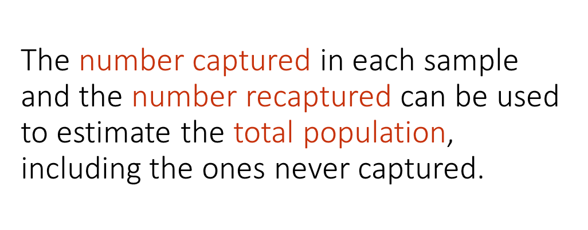
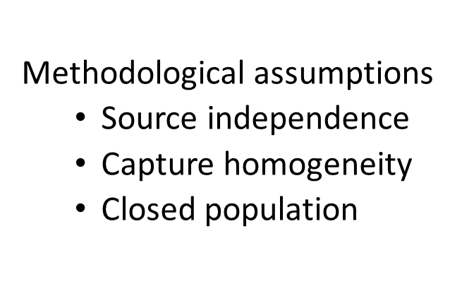
Capture-Recapture Methods
www.engineering.com
Notes:
The basic idea is that with some methodological assumptions, the number captured in each sample and the number recaptured can be used to estimate the total population, including the ones never captured.

Slide 13
Data

Slide 14
Case Surveillance Data
COVID-19 cases reported from public health departments using a CDC standardized case report form (CRF)
Included cases with either a date of death during March 17–April 29, 2020, or with a missing date of death and available CDC report date during March 27–May 9, 2020
10-day reporting lag determined using average difference between date of death and CDC report date among complete health care personnel cases
Health Care Personnel: ?
Notes:
So, let’s talk about our data.
As stated previously, national case surveillance data on laboratory-confirmed COVID-19 cases is voluntarily reported to CDC from state, local, and territorial health departments.
COVID-19 cases are reported from public health departments using a CDC standardized case report form (CRF) that collects information on patient demographics, HCP status, symptom onset date, underlying medical conditions, and health outcomes, including death.
Cases with either a date of death during March 17–April 29, 2020, or with a missing date of death and available CDC report date during March 27–May 9, 2020, were included.
The 10-day reporting lag was determined using the average difference between date of death and CDC report date among HCP cases with both dates complete and a death date between March 17–April 29, 2020

Slide 15
Media Report Data
getblogo.com
Data abstracted from media reports were identified via web-scraping techniques with date of death during March 17–April 29, 2020.
Notes:
Our media data were abstracted from media reported via web-scraping techniques with date of death during our time frame: March 17th through April 29th, 2020.

Slide 16
Identification of Common Cases among Sources
Probabilistic Record Linkage
Similarity scores based on
date of death
age
gender
county and state of residence
Health Care Personnel: ???
Manual review
patient race/ethnicity
underlying medical conditions
Final matched health care personnel cases
matched in at least 4 of the 5 factors
without disagreement in manual review
Notes:
The two data sources were matched using a probabilistic record linkage technique.
Similarity scores were based on date of death, age, gender, and county and state of residence.
Manual review among potential matches was performed by evaluating patient race/ethnicity and underlying medical conditions when these data were available.
Final matched HCP cases were defined as having matched fields in at least four of the five factors and without disagreement in the manual review.
In case of questions:
Among media reported cases, unknown state of residence was filled using the facility location where the HCP had worked.
Age differences of two years or less, death date differences of two days or less, and counties within a one-hour drive, were considered agreeable matches.

Slide 17
Primary Results

Slide 18
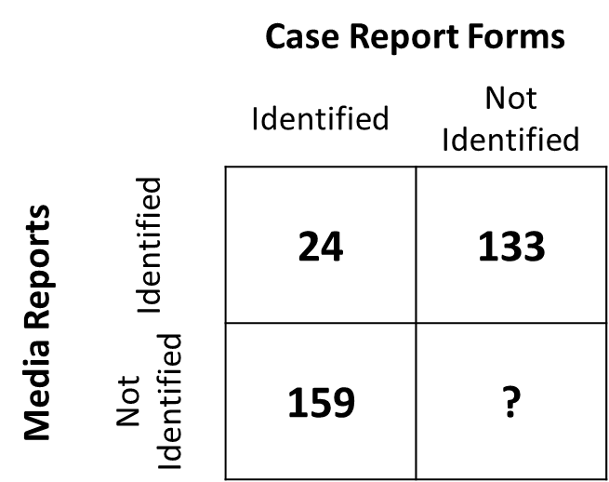


Chapman Estimator
with 0.5 transformed logit 95% confidence interval (Sadinle, 2009)
‘nearly unbiased estimator’
adjusts the Lincoln-Peterson estimate by diminishing small sample bias
$$Standard Lincoln−Peterson:$$
K
k
=1161 (862, 1695)
n
Notes:
Our primary analysis was to calculate the Chapman estimator, which is a nearly unbiased estimate that adjusts the standard Lincoln-Peterson estimate by diminishing small sample bias. When we do this, we obtain an estimate of 1,161 deaths among HCP with a confidence interval of 862 through 1,695.
For questions:
N = number of HCP who have died
n = number of HCP identified by the Case Report Forms (159+24=183)
K = number of HCP identified by Media Report (133 + 24 = 157)
k = number o HCP identified by both (24)

Slide 19

Assumption Violations
The reliability of the Chapman estimator depends on the following assumptions
  total population size is invariant between sources
  homogenous capture probability
  capture sources are independent of one another
  perfect matching between sources
Potential violations were expected
  some states more likely to have strong media coverage of health care personnel related deaths during March 17–April 29, 2020
  other states known to produce more accurate surveillance reports
ThoughtCo
Notes:
The reliability of the Chapman estimator depends on the following assumptions:
(1) the total population size is invariant between sources
(2) capture probability is homogenous, that is within each source all health care personnel deaths are equally likely to be identified
(3) capture sources are independent of one another. In other words, being identified by one source does not make a health care personnel death more or less likely to be identified by a second source.
(4) perfect matching between sources
Potential violations of assumptions (2) and (3) were expected since some states were more likely to have strong media coverage of health care personnel related deaths during our time frame and alternatively, other states were known to produce more accurate surveillance reports

Slide 20
Sensitivity Analyses

Slide 21

Sensitivity Analyses
Three sensitivity analyses were conducted to control for the potential heterogeneous capture probability within the surveillance data and the resulting dependency between data sources.
These included
  Chandra Sekar & Deming estimator (C-D) combined with the Greenfield estimator (G)
  stratified analyses
  a multinomial logistic regression model
www.thestrokeelf.net
Notes:
Three sensitivity analyses were conducted to control for the potential heterogeneous capture probability within the surveillance data and the resulting dependency between data sources.
These included
(1) The Chandra Sekar & Deming estimator (C-D) combined with the Greenfield estimator (G)
(2) Stratified analyses
(3) a multinomial logistic regression model

Slide 22

Chandra Sekar & Deming Estimator (C-D) with the Greenfield Estimator (G)
The C-D estimator is equivalent to the Lincoln-Peterson estimator.
The Greenfield estimator is a supplement
  G > C-D implies positive correlation between sources
    C-D underestimates population size
    G provides an upper limit
    C-D provides a lower limit
  G < C-D implies negative correlation between sources
    C-D overestimates population size
    G provides a lower limit
    C-D provides an upper limit
  In both cases, the true population size lies between the C-D and G estimators
qcs.co.uk
Notes:
The Chandra Sekar & Deming estimator, which we will refer to here as the C-D estimator, is equivalent to the standard Lincoln-Peterson estimator.
Whereas the Lincoln-Peterson and Chapman estimators were established for wildlife populations and assume that the data systems identify cases from subsets of the full population, the C-D estimator was established for demography and assumes that at least one data source (typically a surveillance system) identifies cases from the full population (Sekar and Deming 1949, Sutter and Cochi 1992).
We originally chose the Chapman estimator over the Lincoln-Peterson estimator due to our small sample size, but the benefit of using it here is that when combined with the Greenfield estimator we can adjust for some of the dependence between sources.
The Greenfield estimator is a supplement to the C-D estimator when the assumption of independence between sources is violated.
If G > C-D, then positive correlation between sources is implied, C-D is taken to underestimate the population size, G provides an upper limit, and C-D provides a lower limit to the number of missed events.
If G < C-D, then the opposite is true: negative correlation is observed and the roles of the two estimators are reversed.
In both cases, it is assumed that the true population size lies between the C-D and G estimators (Greenfield 1975, Greenfield 1976, Greenfield 1983).

Slide 23


Stratification
Classic method for minimizing correlation between data sources
Stratified by
  State specific reporting probability
  Age: < 60 years and ≥ 60 years
Calculated the Chapman estimator and 0.5 transformed logit 95% confidence interval for each stratum
Summed the stratum-specific estimates and 95% confidence limits to produce overall population estimates
Notes:
Stratification is the classic method for minimizing correlation between data sources.
We stratified by the state-specific reporting probability, age, and state-specific reporting probability crossed with age.
The state-specific reporting probability was defined as the the state-specific probability of having complete health care personnel and vital status data. In other words, 1 – (probability of missing HCP status or vital status data)) based on the full CRF data.
Age was stratified into two categories: < 60 years and ≥ 60 years based on the known pathology of COVID-19.
We calculated the Chapman estimator and 0.5 transformed logit 95% confidence interval for each stratum and then summed the stratum-specific estimates and 95% confidence limits to produce overall population estimates.

Slide 24


Multinomial Logit Models
Minimize correlation by relating characteristics of persons captured to their probability of being captured by each data source
Parameter estimates are used to estimate the proportion of the population missed, assuming the population has the same covariate distribution as the sample
Advantage compared to stratification: can incorporate the effect of multiple individual-level covariates simultaneously
Advantage compared to log-linear models: include continuous or interaction variables
Notes:
Multinomial logit models minimize correlation by relating characteristics of persons captured to their probability of being captured by each data source.
The resulting parameter estimates are used to estimate the proportion of the population missed, with the assumption that the population has the same covariate distribution as the sample (Alho 1990, Tilling and Stern 1999).
The advantage over stratification is that multinomial models can incorporate the effect of multiple individual-level covariates simultaneously and (unlike log-linear models) may include continuous or interaction variables.

Slide 25

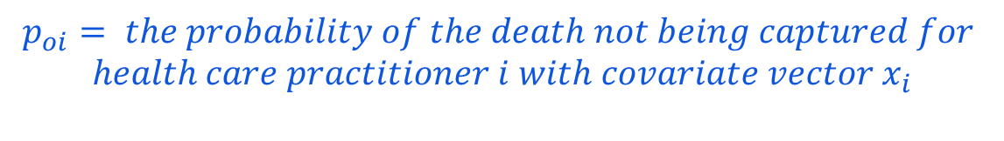
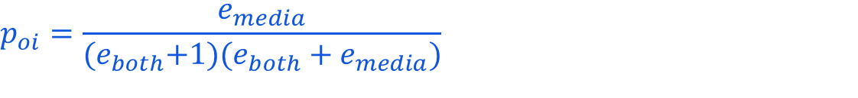

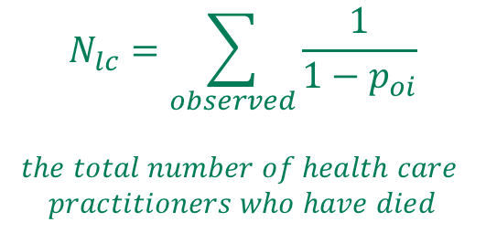
Multinomial Logit Models
Tilling and Sterne, 1999
DOI: 10.1093/oxfordjournals.aje.a009825
Step 1:
Step 3:
$e_{media }=exponentiated logit\left(media\right)$
$$N_{lc}=\sum_{observed}{\frac{1}{1−p_{oi}}}$$
$$the total number of health care$$
$$practitioners who have died$$
$$e_{both}=exponentiated logit (both)$$
Step 2:
$$p_{oi}=\frac{e_{media}}{{(e}_{both}+1)(e_{both}+e_{media})}$$
$$p_{oi}= the probability of the death not being captured for$$
$$health care practitioner i with covariate vector x_{i}$$
Notes:
Specifically, the goal of fitting a multinomial logit model is to estimate the probability of a HCP death being captured by surveillance, media or both, estimate the odds of each outcome as a function of covariates, and express the results in terms of odds ratios.
A 1999 paper by Tilling and Sterne in the American Journal of Epidemiology shows how these estimates relate to the proportion of unobserved cases.
In this slide, I try to outline how this is applied on a very basic level.
Using the surveillance data (or the CRF) data as the reference category, the multinomial model in SAS presents us with the logit of the media and the logit of both. In other words, the logarithm of the odds of being captured by the media as compared to being captured by the surveillance data and the logarithm of the odds of being captured by both surveillance and media as compared to being captured by surveillance only.
We use the exponentiated logits to define p sub o, i as the proportion of cases missed by surveillance and media for an individual i with a covariate vector x. Then the total population size is estimated by the sum over all observed individuals of (1/(1-poi)).
Small levels of missingness among covariates were accounted for with multiple imputation. Our confidence interval was generated using bootstrap replicates. To combine these two methods, we generated bootstrap replicates from the unimputed data, performed MI and combined imputations within each bootstrap replicate, then produced a 95% CI from the distribution of estimates across bootstrap replicates. In a 2018 paper, Schomaker and Heumann refer to this combination of MI and bootstrap methods as the Boot MI method.
For notes:
The logit function for both versus media only is the difference between the two logits presented.

Slide 26
Sensitivity Analysis Results

Slide 27
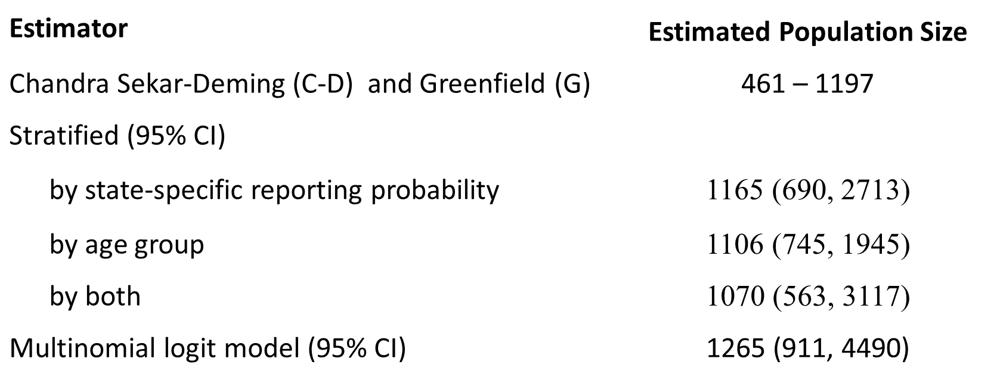
Estimated COVID-19 Deaths Among Health Care Personnel. United States March 17 – April 29, 2020.
Compared to Chapman Estimator (95% CI): 1161 (862, 1695)
Notes:
Here are the results.
Our point estimates range from 1070 when stratifying by both state-specific reporting probability and age group to 1265 when using the multinomial logit model. Based on the confidence intervals our estimates range from 563 to 4,490.
The Chandra Sekar-Deming and Greenfield estimates produce bounds of 461 to 1,197, which, as expected, indicate a negative dependence between sources.

Slide 28
Comparisons to Other Published Estimates
Notes:
Now I will compare our results to other published estimates.

Slide 29
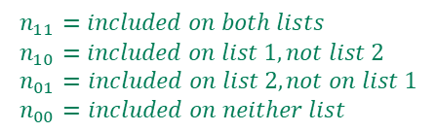
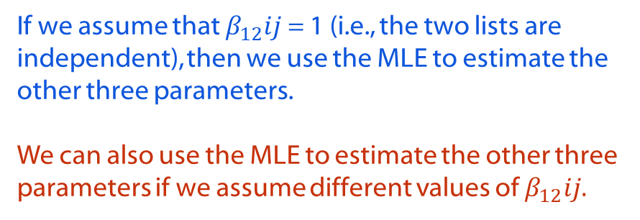


Letter to the Editor of Epidemiology, November 2020
Bo Zhang and Dylan S. Small
Expected size of the population we are estimating
Odds of individual being on list 2
$$n_{ij} \sim Poisson [mean=exp\left(β_{0}+ β_{1}i+ β_{2}j+ β_{12}ij\right)]$$
Odds of individual
being on list 1
Odds ratio of individual being on list 1 given individual is on list 2 compared with not being on list 2
$$i=binary indicator for list 1$$
$$j=binary indicator for list 2$$
If we assume that $β_{12}ij$ = 1 (i.e., the two lists are independent), then we use the MLE to estimate the other three parameters.
We can also use the MLE to estimate the other three parameters if we assume different values of $β_{12}ij.$
$n_{11}=included on both lists$
$n_{10}=included on list 1, not list 2$
$n_{01}=included on list 2, not on list 1$
$n_{00}=included on neither list$
Notes:
Bo Zhang and Dylan S Small from the University of Pennsylvania wrote a letter to the editor of Epidemiology, which was published in November of 2020. In it they used similar methods by matching two website lists. Both websites had online forms for submitting names and information about deceased healthcare workers worldwide.
They model the counts of list 1 (i), list 2 (j), and their overlap as Poisson random variables as outlined in a 1989 Biometrics article by R.M. Cormack. Here I display it as they do. In the log-linear model, beta knot represents the expected size of the population we are estimating, beta 1 represents the odds of an individual being on list 1, beta 2 represents the odds of an individual being on list 2, and beta 1, 2 represents the odds ratio: or the odds of an individual being on list 1 given the individual is on list 2 compared with the odds of an individual being on list 1 given they are not on list 2. Typically, in order to estimate beta knot, beta 1, and beta 2 we assume that beta 1,2 is equal to 1, or in other words, the two lists are independent. But we can set beta 1, 2 to different values in order to conduct a sensitivity analysis.
For questions:
(1) https://www.covid-heroes.com, which appears to no longer be available
(2) In Memoriam: Healthcare Workers Who Have Died of COVID-19 (medscape.com).
(3) We know that the sum of Poisson random variables conditioned on their sum is a multinomial distribution, so this looks very similar to the other capture-recapture techniques that I have already presented.

Slide 30
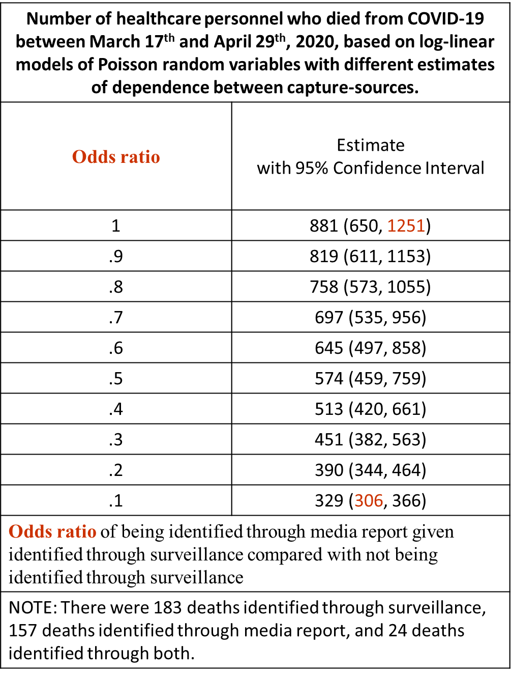
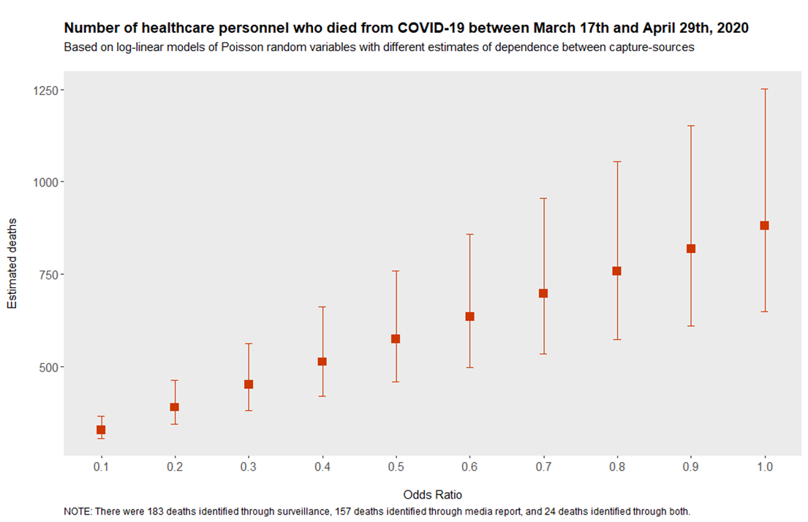
Influence of Different Levels of Dependence between Capture Sources on Log-Linear Capture-Recapture Estimates
881
697
513
329
Notes:
Using their technique, this slide displays different estimates for different odds ratios representing different levels of dependence between the surveillance data and the media report data. We see point estimates ranging from 329 to 881. The lowest value based on the confidence intervals is 306 and the highest value based on the confidence intervals is 1251.

Slide 31
Influence of Different Levels of Dependence between Capture Sources on Log-Linear Capture-Recapture Estimates
Chandra Sekar-Deming and Greenfield: 461 – 1197
881
697
513
329
Notes:
This is strikingly similar to the Chandra Sekar-Deming and Greenfield estimators, which provide the bounds 461 to 1,197.

Slide 32
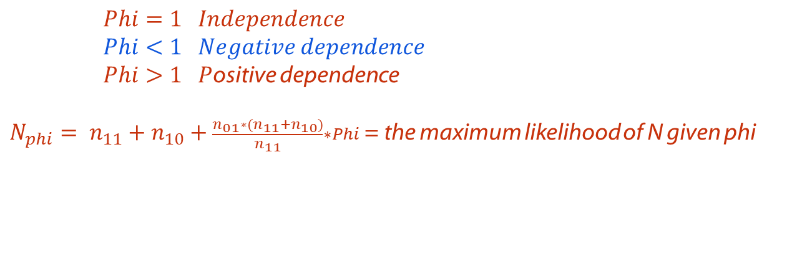
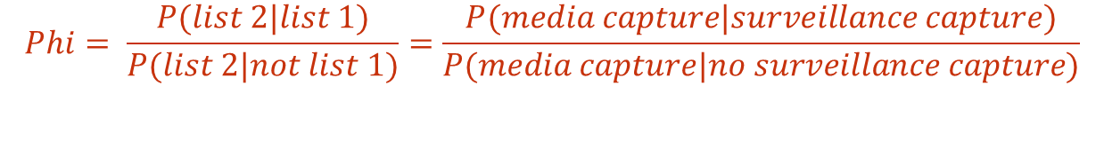
2021 Joint Statistical Meetings
Yuzi Zhang, Emory University
$$Phi= \frac{P(list 2|list 1)}{P(list 2|not list 1)}=\frac{P(media capture|surveillance capture)}{P(media capture|no surveillance capture)}$$
$Phi=1 Independence$
$Phi<1 Negative dependence$
$Phi>1 P$ositive dependence
$N_{phi}= n_{11}+n_{10}+\frac{n_{01}∗(n_{11}+n_{10})}{n_{11}}∗Phi$ = the maximum likelihood of N given phi
Notes:
Yuzi Zhang, a PhD student at Emory University gave a nice presentation at JSM which proposed an approach for conducting sensitivity analyses of capture-recapture methods. In it, she introduced the parameter phi. Phi is the probability of being captured in the second stream, given an individual is captured in the first stream over the probability of being captured in the second stream, given an individual is NOT captured in the first stream. For us this is the probability a health care worker is captured by the media, given they are captured by the case report forms over the probability a health care worker is captured by the media, given they are NOT captured by the case report forms. Ms. Zhang presented an MLE estimate for known values of phi with an approach for developing credible intervals. I am not presenting the credible intervals here, but find this a useful way to visualize our estimates.
For questions:
Psi is not estimable from the data, but we can assume a distribution for phi and use the data to specify a distribution for the numerator in order to obtain estimates of psi.

Slide 33
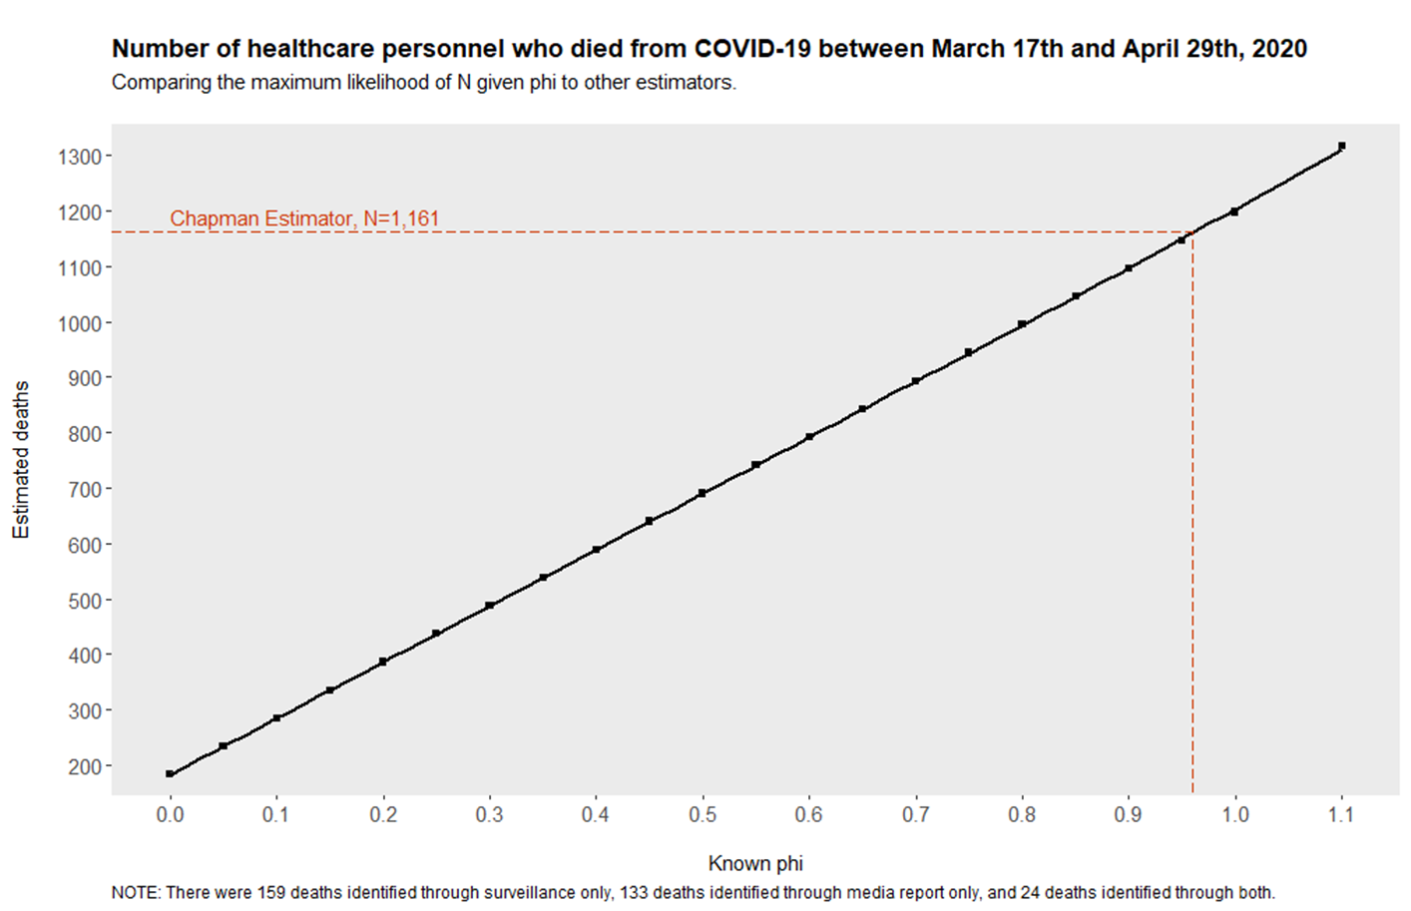
Notes:
In the figure, we have phi on the x-axis, the number of estimated deaths on the y-axis, and the MLE of Nhat given phi along the black line. The MLE is biased, but consistent
Adding the Chapman estimator to this figure, we see that based on the MLE of N given phi, the Chapman estimator corresponds to a phi of 0.96, or nearly 1.

Slide 34
Chapman estimator, N=1,161
Notes:
This plot provides all the estimates together.
When stratifying by both age and state-reporting probability, phi is 0.87 (as shown by the dotted blue line).
For the multinomial regression, phi is approximately 1.07 (as shown by the dotted green line), which corresponds to positive dependence between the surveillance capture and the media capture. This could indicate a violation to the assumption for the multinomial regression that the distribution of covariates in the sample matches the distribution in the true population.
The Chandra-Sekar and Deming and Greenfield bounds are shown as solid purple lines with phi ranging from 0.27 to 1 and the Poisson regression bounds are shown as solid blue lines with phi ranging from 0.12 to 1.05.
From this it seems that the simple methods of stratifying or using the Chandra-Sekar Deming and Greenfield bounds when we know there is dependence between sources provides the easiest and perhaps the most accurate assessment.
It is difficult to verify the assumptions for the multinomial regression and more difficult to implement, particularly when there is some level of missingness within the covariates.
The Poisson regression is informative, but requires a bit more mathematical background to really understand how to implement and interpret it.

Slide 35
Lost on the Frontline
Midpoint of the Chandra-Sekar and
Deming/Greenfield estimate, N=829
300
500
700
900
1100
1300
Chapman Estimate,
N=1,161
Lost on the Frontline estimate,
N=544
Chandra-Sekar &
Deming lower bound
(Greenfield estimate),
N=461
Chandra-Sekar & Deming
estimate/upper bound, 1,197
Notes:
Finally, I’d like to compare our estimates to the Lost on the Frontline effort. Without statistical adjustments we assume that Lost on the Frontline is biased downward and is an underestimate. For March of 2020, Lost on the Frontline estimated 81 deaths among health care personnel and for April of 2020, Lost on the Frontline estimated 463 deaths among health care personnel. This is a total of 544 health care personnel deaths, which lines up nicely with what we believe to be true. We think the Chapman estimate is an overestimate due to capture dependencies, the Lost on the Frontline estimate is an underestimate, and somewhere in the middle lies the true number of health care personnel deaths due to COVID-19 during March 17th through April 29th, 2020.

Slide 36
Conclusions

Slide 37
Conclusions
We estimate the number of healthcare personnel deaths between March 17th and April 29th, 2020 to be somewhere between 461 and 1197, with a mid-point estimate of 829.
Combining available surveillance data with web-harvesting seems to be a legitimate and useful way to establish epidemiological estimates in the absence of more precise data during times of national crisis, particularly during the early stages of a pandemic when it’s more feasible to link media reports to public health line-level surveillance data.

Slide 38
Conclusions
Combining the Chapman estimator with the Chandra-Sekar & Deming/Greenfield estimators is the easiest approach to implement, the easiest to explain, and produces estimates that seem accurate, as compared to our other estimates.
Our other estimates included stratified estimates, estimates based on multinomial regression, estimates based on Poisson regression, and comparisons to known values of phi (assumed to lie between 0 and 1 due to dependence between data sources).

Slide 39
Citations
Burrer SL, de Perio MA, Hughes MM, Kuhar DT, Luckhaupt SE, McDaniel CJ, Porter RM, Silk B, Stuckey MJ Walters M – CDC Covid-19 Response Team. Characteristics of Health Care Personnel with COVID-19 —United States, February 12–April 9, 2020. MMWR Morb Mortal Wkly Rep 2020; 69; 477-481.
https://covid.cdc.gov/covid-data-tracker/#health-care-personnel.
Ing EB, Xu QA, Salimi A, Torun N.: Physician deaths from corona virus (COVID-19) disease. Occupational Medicine 2020;70:370–374. doi:10.1093/occmed/kqaa088
Bandyopadhyay S, Baticulon RE, Kadhum M, et al. Infection and mortality of healthcare workers worldwide from COVID-19: a systematic review. BMJ Global Health 2020;5:e003097. doi:10.1136/bmjgh-2020-003097.
Amnesty International, 2020: Exposed, Silenced, Attacked: Failures to Protect Health and Essential Workers During the COVID-19 Pandemic. Index: POL 40/2572/2020.
https://www.theguardian.com/us-news/ng-interactive/2020/dec/22/lost-on-the-frontline-our-findings-to-date
Petersen, C.G.J.: The yearly immigration of young plaice into the Limfjord from the German sea. Rep. Dan. Biol. St. 6, 5–84 (1896)
Chapman, D.G.: Some properties of the hypergeometric distribution with applications to zoological censuses. Univ. Calif. Publ. Stat. 1, 131–160 (1951)
Notes:
Here are my citations. Please stop the video if you would like to look more closely at these.

Slide 40
Citations
Mauricio Sadinle (2009) Transformed Logit Confidence Intervals for Small Populations in Single Capture–Recapture Estimation, Communications in Statistics - Simulation and Computation, 38:9, 1909-1924, DOI: 10.1080/03610910903168595
Greenfield, CC. On the Estimation of a Missing Cell in a 2 x 2 Contingency Table. Journal of the Royal Statistical Society. Series A (General). 1975; 138(1):51-61. https://www.jstor.org/stable/2345249
Greenfield, CC. A Revised Procedure for Dual Record Systems in Estimating Vital Events. Journal of the Royal Statistical Society. Series A (General). 1976; 139(3):389-401. http://www.jstor.com/stable/2344844
Greenfield, CC. On Estimators for Dual Record Systems. Journal of the Royal Statistical Society. Series A (General). 1983; 146(3):273-280. https://www.jstor.org/stable/2981655
Sekar, C., Deming, W.E.: On a method of estimating birth and death rates and the extent of registration. J. Am. Stat. Assoc. 44, 101–115 (1949)
Alho JM. Logistic regression in capture-recapture models. Biometrics. 1990;46:623-35.
Tilling K, Sterne, JA. Capture-recapture models including covariate effects. Am J Epidemiol. 1999;149(4):392–400. doi: 10.1093/oxfordjournals.aje.a009825.
Zhang B, Small DS. Number of Healthcare Workers Who Have Died of COVID-19, letter to the editor. Epidemiology. 2020; 31(6).

Slide 41
Jennifer Rammon
LMI3@cdc.gov
Notes:
Thank you very much for your attention. Please reach out to me during FCSM or via email with any questions or comments you may have.

