Slide 1
Patterns of Response During Covid-19 in a National Survey of Businesses:
A Look at the Medical Expenditure Panel Survey – Insurance Component (MEPS-IC)
David Kashihara
Agency for Healthcare Research and Quality
FCSM Research and Policy Conference – November 2021

Slide 2
Disclaimer
The views expressed in this presentation are those of the author and no official endorsement by the Department of Health and Human Services or the Agency for Healthcare Research and Quality is intended or should be inferred.

Slide 3
Presentation Outline
Introduction to MEPS
Insurance Component (IC)
  Background
  Changes due to COVID-19
Survey Response
  Response by survey characteristics
Summary
Moving Forward & Continuing Research

Slide 4
Medical Expenditure Panel Survey (MEPS)
Household Component (HC)
  Annual survey of households
  Survey administered by Westat
Medical Provider Component (MPC)
  Sample of providers of services to HC respondents
    Physicians
    Hospitals
    Home health agencies
    Pharmacies
  Administered by RTI International
Insurance Component (IC)
  Annual survey of
    Business establishments
    State & local governments
  Survey administered by the U.S. Census Bureau

Slide 5
Medical Expenditure Panel Survey
Insurance Component (MEPS-IC)
Annual sample
  Over 42,000 business establishments
  Over 3,300 State & local governments
  This presentation will only cover private sector (businesses) operations
National & State-level estimates
  % of employers offering health insurance
  # of enrolled employees
  Average health insurance premiums, copays & deductibles

Slide 6
COVID and the MEPS-IC
Operations at time of Fed Gov’t Covid shutdown
  Census Bureau’s National Processing Center (NPC) shut down on March 18, 2020
  Sample being prepared
  Research about to begin
    Update contact information
    Find contact within business to respond to the survey
    Conducted by analysts at the NPC
  Prescreener data collection operation ready

Slide 7
2020 MEPS-IC Survey Operations
Summary of Covid Effects
Sample
  Frame set in March
  Sample drawn in April
  No changes due to Covid
Research
  Analysts update contact information for sampled businesses
  Find best contact within the business to send the survey
  Initially canceled; operation completed
Telephone Pre-screener
  Determine if offer insurance. If no - end of survey
  Initially delayed; operation completed
  Added collection of email address for future web contacts

Slide 8
2020 MEPS-IC Survey Operations
Summary of Covid Effects
Mail & Web
  Survey forms mailed if offer insurance or nonresponse to pre-screener (primary option)
  Web response option given in introductory letter of mailed survey forms packet & on first page of mailed survey form
  Mail: canceled
  Web: only response option
    Survey shifted to web response as primary option
  Paper forms mailed to some businesses once NPC re-opened
  Mail response: 24.1% in 2019 → 10.5% in 2020
  Web response: 37.8% in 2019 → 50.0% in 2020
Personal Visit
  Very few – only for the largest-size non-respondents
  No personal visits in 2020
Telephone Follow-up
  For establishments with no response via mail or web
  Extended field period to increase response

Slide 9
Covid and the IC: Issues & Concerns
Survey Operations
  NPC shut down → no Research, Prescreener or Mailout operations
    No contact information updates & no contact information for some businesses
    Major data collection operations halted
  Telephone interviewers not telework-ready
  Telephone follow-up (TFU) operation may be overwhelmed (volume)
  Skeleton staffing → capabilities & pace of operations compromised
    Manual operations by Census NPC & HQ staffs
Survey Respondents
  Certain industries may be severely affected
  Certain regions or areas may be severely affected
  Temporary & permanent business closures
  Changes in business structure → furloughs, telework, etc.
Survey Challenges
  Identifying business closures vs non-response
  High unit non-response
    May vary by industry, firm size & location
  Quality of State-level estimates

Slide 10
MEPS-IC Private Sector
Overall Response Rate

Slide 11
Data Collection: Prescreener
Prescreener Operation
  Brief telephone interview
  Determine offer insurance status
    Yes: receive full survey (web & mail response options)
    No: ask business characteristics questions & end survey
  June 2020 – August 2020
  Phone centers closed
    Interviewers worked remotely for the first time

Slide 12
IC Prescreener Response Rates
Prescreener Response Rates
Decreasing, but relatively small change from 2018 to 2019
Year | 2018 | 2019 | 2020
Response Rate (%) | 58.6 | 54.8 | 44.9
# of Establishments | 39,487 | 39,315 | 39,426

Slide 13
IC Prescreener Response Rates
Prescreener Response Rates
2020 response rates decline in all NAICS-2 industries
Industries with lowest response rates include [NAICS-2]:
  Agriculture, forestry, fishing, hunting [11]
  Real estate [53]
  Accommodation, food services [72]
  Publishing, movies, broadcasting, telecommunications [51]
Year | 2018 | 2019 | 2020
Response Rate (%) | 58.6 | 54.8 | 44.9
# of Establishments | 39,487 | 39,315 | 39,426

Slide 14
2020 MEPS-IC Post-Prescreener Response
MEPS-IC private sector response
  Preliminary high-level examinations
    By industry
    By type of firm (single unit vs multiunit)
    By firm size
  Overall response rates close to previous years
  Response rates fairly consistent across subgroups of respondents
Response bias analyses in progress

Slide 15
MEPS-IC Response Rate
By Industry (2-Digit NAICS)

Slide 16
MEPS-IC Response Rate
By Type of Firm

Slide 17
MEPS-IC Response Rate
By Firm Size

Slide 18
Response by Mode
Initial push during COVID to move the IC from a mail & web survey to a web-only survey
Census Bureau currently moving economic surveys to web-only format
Effects of promoting web response over mail
  Data quality?
  Bias?
  Certain industries prefer mail response
  Smaller firms prefer mail response

Slide 19
MEPS-IC
Response Percentages by Mode

Slide 20
2019 & 2020 MEPS-IC
Response Percentage by Mode & Firm Size

Slide 21
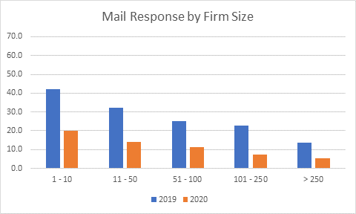
2019 & 2020 MEPS-IC
Response Percentages by Mail & Firm Size

Slide 22
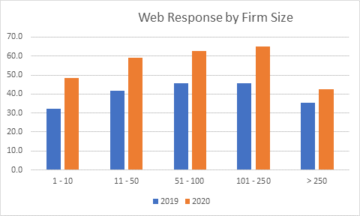
2019 & 2020 MEPS-IC
Response Percentages by Web & Firm Size

Slide 23
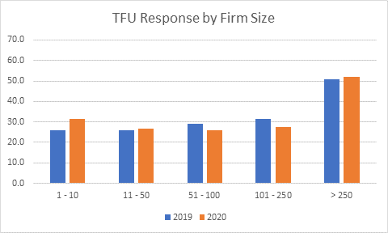
2019 & 2020 MEPS-IC
Response Percentages by Phone & Firm Size

Slide 24
2019 & 2020 MEPS-IC
Response Percentage by Mode & Firm Size

Slide 25
MEPS-IC
Mail vs Web Response
Before 2020
  Mail becomes steadily less popular as firm size increases
  Mail only more popular than web for the smallest firms (1-10 employees)
  Web more popular than mail for all other firm sizes
  Data quality (Kashihara, 2019)
    Better quality likely due to automated edits in web instrument
    Web reporting issues include:
      Internet access
      Some respondents not computer savvy
      Paper surveys preferred by some
During 2020
  Web response more prevalent in all firm size categories
  Mail becomes steadily less popular as firm size increases

Slide 26
Response Mode by Industry (NAICS-2)
Findings from an analysis of 2017 MEPS-IC data
Web response more popular than mail
  Most industries
Mail response more popular than web
  Agriculture, Forestry, Fishing & Hunting
  Retail Trade
  Warehousing & Storage
  Other Services
    Repair & Maintenance
    Personal & Laundry Services
    Etc.

Slide 27
Summary
Covid-based MEPS-IC disruptions in 2020
  Survey operations
  Sampled businesses
Overall private sector response rate
  2019: 59.2%
  2020: 56.3%
Response rate by industry, type of firm, firm size
  Generally followed annual trends
Response by mode noticeably altered
  Shift in primary survey mode: mail → web
  Overall response rate relatively unchanged from 2019

Slide 28
Moving Forward
2021 Survey Operations
  Data collection operations will be similar to 2020
    Initial Mail
      2019: letter & survey forms (paper response w/ web option)
      2020: letter only (web response)
      2021: letter only (web response)
    Mail Follow-up
      2019: follow-up letter & survey forms
      2020: follow-up letter & survey forms
      2021:
        1st mail follow-up: follow-up letter & fact sheet
        2nd mail follow-up: follow-up letter & survey forms

Slide 29
Continuing Research
2021 Research Projects
  COVID survey questions
  2020 MEPS-IC data quality analysis
  2020 MEPS-IC bias analysis
  Independent pilot study
    5,000 establishments
    Remove costly & time-consuming operations
      No Research, Prescreener or TFU
    Examine effects on estimates, response & bias

Slide 30
Contact Information
David Kashihara
Email: David.Kashihara@ahrq.hhs.gov
Thank You!

