Slide 1

Evaluating Crime Survey Responses and Engagement among Juveniles and their Parents using Social Media and Online Platforms
Jenna Truman, Grace Kena, & Chris Krebs
(Bureau of Justice Statistics) (RTI International)
November 2, 2021 | FCSM Research & Policy Conference

Slide 2
Overview
National Crime Victimization Survey (NCVS)
NCVS Instrument Redesign
This session – will cover promising practices and lessons learned form recruiting and surveying victims using social media and online platforms
This presentation – will look at crime survey responses among juveniles and their parents
Remainder of this session – will cover testing hate crime items; enhancing identify theft measurement; general lessons learned and discussion

Slide 3
NCVS overview
One of the nation’s two major sources of data on criminal victimization (along with the FBI’s Uniform Crime Reporting program)
Collects information on nonfatal violent and property crimes reported and not reported to police (measures the ‘dark figure’ of unreported crime)
Annual data collection administered by the U.S. Census Bureau
Panel design survey: households remain in sample for 3.5 years
Self-report survey: household persons asked about criminal victimizations experienced during prior 6 months and self-report demographic information
Incident-based survey: collects information about each victimization incident
For more information see NCVS webpage: https://bjs.ojp.gov/data-collection/ncvs

Slide 4
NCVS instrument redesign
BJS currently undertaking major, multi-year redesign of NCVS survey instruments
  Household roster, crime screener, crime incident report
Survey last redesigned in 1992
Key focus to modernize survey content and organization
BJS working with external contractor, Westat, and U.S. Census Bureau on instrument redesign
Instrument testing has included a pilot and national field test and multiple rounds of cognitive and usability testing, as well as online testing of specific topics (juveniles, hate crime (with RTI International))

Slide 5
Goals of the new NCVS instrument
Modernize survey instrument design and methodology
Generate better and more comprehensive measures of crime
Engage non-victims and collect more contextual information
  Add questions on respondents’ perceptions of safety, disorder, police legitimacy, and satisfaction with police
Expand information collected on victim experiences
    Knowledge about victim service use
    Citizen satisfaction with police
    Understanding of the consequences of victimization

Slide 6
Juvenile (Ages 12-17) Testing for NCVS Redesign

Slide 7
Purpose of juveniles testing
Evaluate comprehension and relevance of the redesigned NCVS instrument for youth
Evaluate quality of data collected from youth
Understand reasons for nonresponse and develop strategies for increasing youth participation
Assess the efficacy of proxy reporting for youth (currently used for youth ages 12-13 parental refusals or unable to respond to survey)

Slide 8
Best laid plans for testing
Planned for in person testing at RTI locations
  Youth cognitive interviews
  Parent cognitive interviews
But COVID-19 pandemic changed those plans
All interviews were shifted to virtual
Virtual format allowed for greater geographic diversity

Slide 9
Recruitment
Targeted parents of youth in the age range
Conducted virtually through online platforms
  Mechanical Turk (MTurk), Facebook, Instagram, Reddit, and Pinterest ads
For this population, social media ads cost less than MTurk with a greater return
Social media ads included graphic with study information and link to screener survey
Emphasis on recruiting victims

Slide 10

Example social media ad

Slide 11
Recruitment (cont.)
Parents completed online web screener
  They were also asked to forward screener survey to other parents with kids in this age range
Recruiters reviewed data to decide which families to contact with a goal of having variation in both demographics and victimization types
  Noticeable discrepancies in victimization information given by parents compared to youth final classification
Parental consent obtained in initial call; consent/youth assent forms emailed to participants

Slide 12
Interview methods
Two rounds of youth cognitive interviews
Two rounds of parent cognitive interviews
Interviews conducted via Zoom, respondents required to be in private setting
Scheduled 45 minute interviews
Interviewers had emotional distress protocol
Respondents provided $40 Amazon gift card

Slide 13
Youth cognitive interviews
Focus on comprehension of survey items
NCVS redesign instrument protocol included both structured and unstructured probes
Asked youth (N=106) about –
  Understanding of concepts, such as threats, physical force
  Relevance of examples, like types of items stolen
  Challenges to participating in the NCVS
Revisions made to survey questions after round 1 of testing
In round 2 of testing, if victim, asked for interest in participating in second interview

Slide 14
Demographics reported by parents in the eligibility form for all 106 youth cognitive interviews across both phases
Cognitive interview sample, by demographic characteristics for Phase 1 and Phase 2 participants
Demographic characteristics |  | Total
 |  | Count | Percent
 | Total | 106 | 100 | %
Sex | Male | 45 | 42 | %
 | Female | 61 | 58
Age | 12 | 19 | 18 | %
 | 13 | 21 | 20
 | 14 | 15 | 14
 | 15 | 15 | 14
 | 16 | 23 | 22
 | 17 | 13 | 12
Race/ Ethnicity | Hispanic | 30 | 28 | %
 | White | 66 | 62
 | Black | 31 | 29
 | American Indian/Alaska Native | 6 | 6
 | Asian | 9 | 8
 | Hawaiian/Pacific Islander | 3 | 3
 | Other | 12 | 11
 | More than one race | 28 | 26
Household Income | Below $30,000 | 18 | 17 | %
 | Above $30,000 | 82 | 77
 | Prefer not to say | 6 | 6

Slide 15
Parent cognitive interviews
Parents given detailed review of current NCVS recruitment and interview process
Asked parents (N=73) about –
  Decisions about their child(ren)’s participation
  Concerns about time commitment, confidentiality, topic sensitivity
  Willingness to allow direct communication between interviewers and their child(ren)
  Their thoughts on child(ren)’s likelihood of participation
Elicited feedback on various NCVS recruitment materials

Slide 16
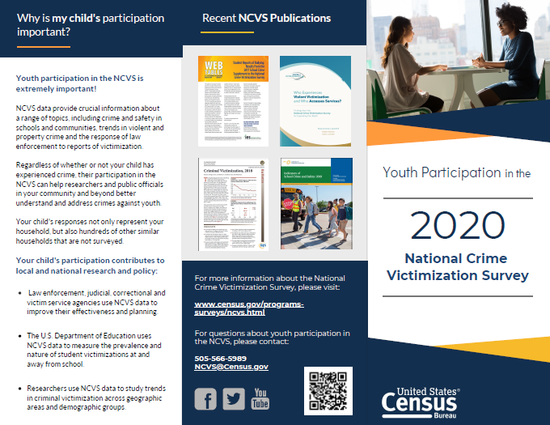
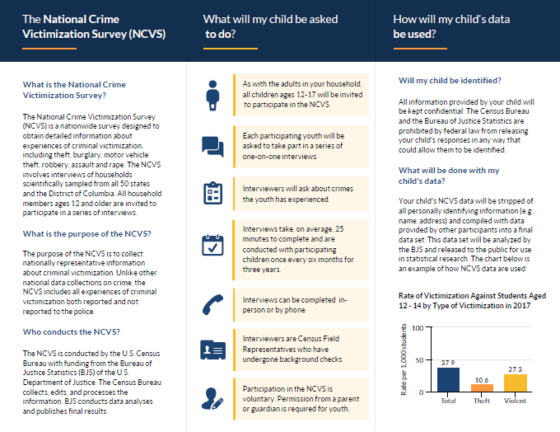
Example of brochure

Slide 17
What we learned about online testing
Virtual interviewing generally worked well
Interviewers were able to keep respondents engaged and on task, but limited timing
With proper training, interviewers were able to monitor and recognize distress during video interviews
Larger geographic diversity possible
Majority of participants identified from social media advertisements
Recognize limitations of access to internet and technology for virtual interviews

Slide 18
What we learned about the content
Instrument
  Youth generally understood items
  Clarification needed on certain concepts, like confidentiality
  Consider youth-specific incidents like virtual items being stolen or incidents that were accidental or playing
Participation in the NCVS
  Parents positive about brochures, would like to see example questions, and interested in scheduling portal
  Respondent recruitment materials should appeal to parents’ and youth’s ability to contribute to society, research, and national crime statistics

Slide 19


Jenna Truman
Statistician
Victimization Statistics Unit
jennifer.truman@usdoj.gov
810 Seventh Street, NW, Washington, DC 20531 | Phone: +1 (202) 307-0765 | bjs.ojp.gov

