Slide 1
Exploring Disparities in the Nation’s Health
David T. Huang, PhD, MPH, CPH (CDR, USPHS) (dhuang@cdc.gov)
Chief, Health Promotion Statistics Branch
National Center for Health Statistics
Centers for Disease Control and Prevention
Federal Committee on Statistical Methodology (FCSM)
Research and Policy Conference
November 2, 2021

Slide 2
Overview of Healthy People

Slide 3
What is Healthy People?
Provides a strategic framework for a national prevention agenda that communicates a vision for improving health and achieving health equity
Identifies science-based, measurable objectives with targets to be achieved by the end of the decade
Requires tracking of data-driven outcomes to monitor progress and to motivate, guide, and focus action
Offers model for international, state, and local program planning
3
Notes:
3

Slide 4
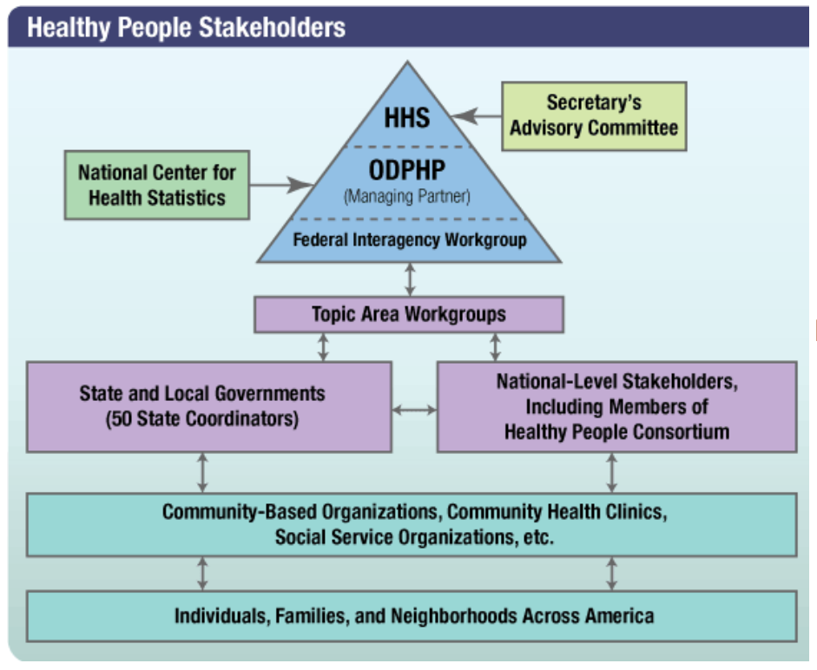
4

Slide 5
How is Healthy People Used?
For research/assessment:
As a data source | 91%
To inform program planning to address health disparities | 82%
For comparison with organization data (e.g. benchmarking) | 80%
To develop community health improvement plans | 79%
To conduct community health assessments | 70%
For meeting national public health accreditation standards | 51%
For collaboration/outreach or education:
As a resource for building community partnerships for promoting health | 73%
As a learning tool for staff or students | 67%
For setting internal priorities:
As a framework for planning, goal-setting or decision making | 79%
To guide priorities for the organization/entity | 73%
As a guide for allocating resources in the organization/entity | 40%
Other uses:
To support applications for grants or other funding | 79%
To inform policy development | 70%
To create or inform quality improvement activities | 66%
Other, please specify | 29%
From Healthy People 2015 User Study by NORC at the University of Chicago, based on a sample of 573 Healthy People State Coordinators, Senior State/Territory Deputy Directors, Local Health Departments, Tribal entities, Tribal Area Health Boards, Consortium organizations, and Healthy People Webinar attendees
5

Slide 6
Role of NCHS in Healthy People
Methods and measures
Statistical approaches and target-setting methods
Healthy People databases
Analysis and presentation of data
Expertise and technical assistance
6

Slide 7
Disparities and Healthy People

Slide 8
History
1985: HHS Report of the Secretary’s Task Force on Black & Minority Health (Heckler Report)
Healthy People Overarching Goals:
HP2000: Reduce health disparities
HP2010: Eliminate health disparities
HP2020: Achieve health equity, eliminate disparities, and improve the health of all groups
HP2030: Eliminate health disparities, achieve health equity, and attain health literacy to improve the health and well-being of all
8

Slide 9
Definitions
Health disparity: A particular type of health difference that is closely linked with social, economic, and/or environmental disadvantage. Health disparities adversely affect groups of people who have systematically experienced greater obstacles to health based on their racial or ethnic group; religion; socioeconomic status; gender; age; mental health; cognitive, sensory, or physical disability; sexual orientation or gender identity; geographic location; or other characteristics historically linked to discrimination or exclusion.
Health equity: Attainment of the highest level of health for all people. Achieving health equity requires valuing everyone equally with focused and ongoing societal efforts to address avoidable inequalities, historical and contemporary injustices, and the elimination of health and health care disparities.
Source: Healthy People 2020 [Internet]. Washington, DC: U.S. Department of Health and Human Services, Office of Disease Prevention and Health Promotion [cited October 21, 2021]. Available from: https://www.healthypeople.gov/2020/about/foundation-health-measures/Disparities.
9

Slide 10
Disparities: Evolution of Measurement
 | HP2000 | HP2010 | HP2020 | HP2030
Overarching Goal | Reduce health disparities | Eliminate health disparities | Achieve health equity, eliminate disparities, and improve the health of all groups | Eliminate health disparities, achieve health equity, and attain health literacy to improve the health and well-being of all
Disparity Targets | Separate targets were set designed to narrow the gap with the total population | No separate disparities targets, but use of “better than the best” target-setting method | No separate disparities targets | No separate disparities targets
Measurement | Absolute disparity Not assessed Relative disparity Not assessed Change in disparity over time ratio of percent change for reference group to percent change for group of interest Reference group Total population | Absolute disparity Not assessed Relative disparity Pairwise rate ratios Index of disparity Change in disparity over time absolute difference between measures above Reference group Best group | Absolute disparity Maximal rate difference Relative disparity Pairwise rate ratios Maximal rate ratio Summary rate ratio Change in disparity over time absolute and relative difference between measures above Reference group Best group | Methods will build on HP2020 methods
10

Slide 11
HP2030 Data Template
Total
Sex
Male
Female
Race/Ethnicity
American Indian/Alaska Native only
Asian only
Native Hawaiian/Pacific Islander only
Black or African American only
White only
2 or more races
Hispanic or Latino
Not Hispanic or Latino
American Indian/Alaska Native only, not Hispanic or Latino
Asian only, not Hispanic or Latino
Native Hawaiian/Pacific Islander only, not Hispanic or Latino
Black only, not Hispanic or Latino
White only, not Hispanic or Latino
2 or more races not Hispanic or Latino
Age
[Standard groups by data system]
Educational Attainment
< High school
High school
Some college or Associates degree
4-year college degree or more
Family Income (percent poverty threshold)
<100
100-199
200-399
>=400
Health Insurance Status
Insured
Private
Public
Uninsured
Geographic Location or Region
Metropolitan
Nonmetropolitan
Marital Status
Married/Cohabiting partner
Divorced or Separated/Widowed
Never married
Country of Birth
US
Outside US
Veteran Status
Veteran
Non-Veteran
Disability Status
People with disabilities
People without disabilities
Sexual Orientation
Straight
Straight, Male
Straight, Female
Gay/Lesbian
Gay, Male
Gay/Lesbian, Female
Bisexual
Bisexual, Male
Bisexual, Female
Gender Identity
[Standard groups by data system]
Notes:
If data are not collected, analyzed, or available (or need to be suppressed) for a particular demographic group by a data source, the demographic label will still be shown and a symbol or acronym will be displayed to indicate the reason data are not shown.
Categories and demographic groups may vary from this template, and additional categories and demographic groups may be included on a case-by-case basis.

Slide 12
Measuring Disparities: HP2020 Methods
Reference point
Absolute vs. relative disparities
Pairwise vs. summary disparities
Disparities over time
12

Slide 13
Reference Point
Possible options:
Largest group
The group with the “best” (most favorable) group rate
The group with the largest social disadvantage
The total population
The average rate
A target or goal rate
The “best” (most favorable) group rate was chosen as the reference point for measuring disparities starting in Healthy People 2010.
13

Slide 14
Absolute vs. Relative Disparity
Absolute disparity: Simple difference between two rates, using the same unit of measure as the indicator.
Also referred to as rate difference and absolute difference
Maximal rate difference is the difference between highest and lowest group rates and was introduced for HP2020; also called the range difference.
Relative disparity: Disparity measured on a relative scale, such as percent difference between rates or the ratio between rates.
Unlike absolute measures, relative measures are unit free, so they can be used to compare objectives measured on different scales and units of measure.
Both absolute and relative disparities should be examined when looking at changes over time.
14

Slide 15
Pairwise Disparities
The primary measure of pairwise disparities (first introduced in HP2010) is a relative disparity, measured as a rate ratio between two rates:
R_{b} (rate for the best group)
R_{g} (rate for a group of interest).
For objectives expressed as favorable events or conditions to be increased, disparity from the best group rate is calculated using the rate ratio: R_{b}/R_{g}.
For objectives expressed as adverse events or conditions to be decreased, disparity from the best group rate is calculated using the rate ratio: R_{g}/R_{b}.
Maximal rate ratio is the rate ratio between highest and lowest group rates and was introduced in HP2020.
15

Slide 16
Summary Rate Ratios
Summary rate ratios are relative disparities calculated as follows:
When there were only two groups (e.g., male and female), the summary disparity ratio is a pairwise disparity.
When there were three or more groups and the most favorable rate (R_{b}) was the highest rate, the summary disparity ratio is calculated as R_{b}⁄R_{a} , where R_{a} = the average of the rates for all other groups.
When there were three or more groups and the most favorable rate (R_{b}) was the lowest rate, the summary rate ratio is calculated as R_{a} ⁄R_{b} .
This concept was introduced in HP2020, though a related concept, the index of disparity, was used in HP2010.
16

Slide 17
Disparities over Time
Changes over time are assessed in HP2020 primarily for:
Maximal rate difference
Maximal rate ratio
Summary rate ratio
17

Slide 18
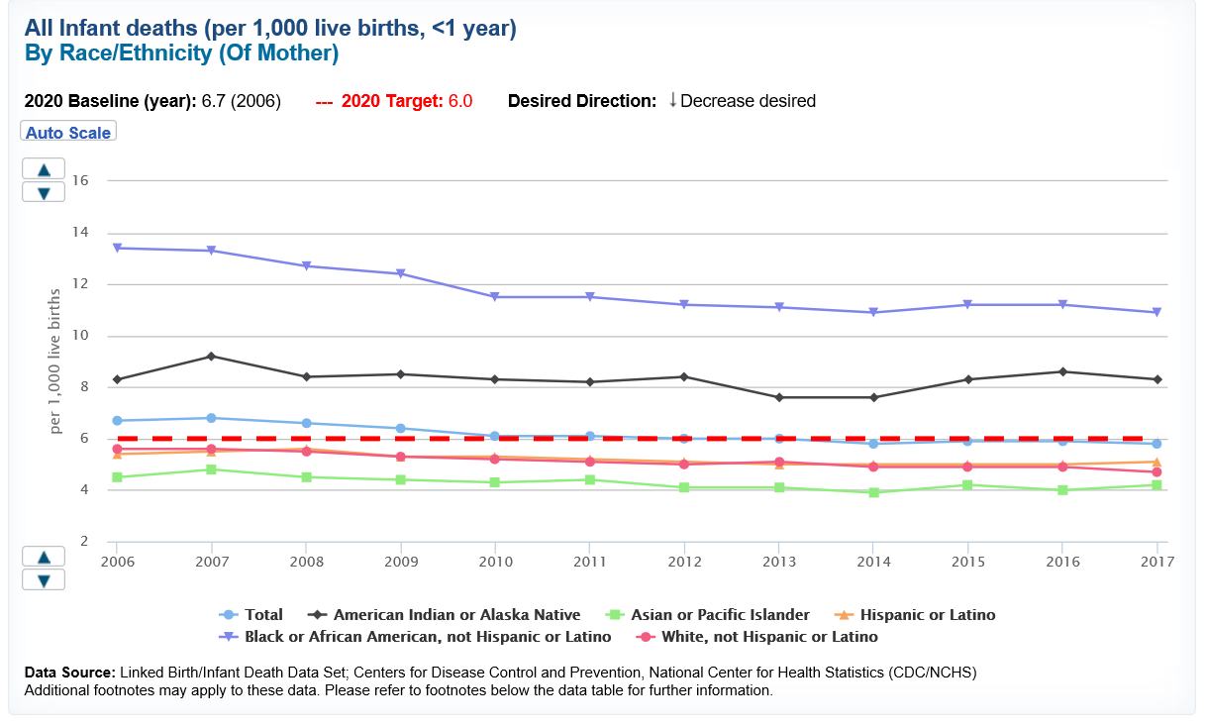
Example: HP2020 Disparities Tool
18

Slide 19
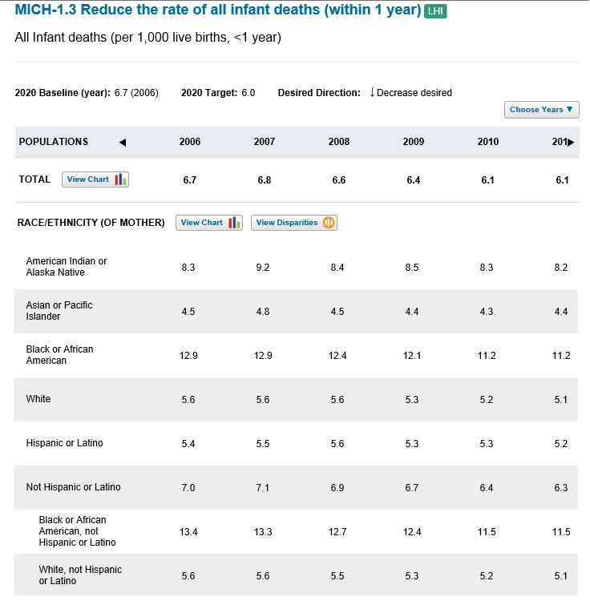
Example (Baseline)
The difference between the best and worst group rates was 8.8 infant deaths per 1,000 live births (maximal rate difference).
$$13.4−4.5=8.8$$
The worst group rate was 2.934 times the best group rate (maximal rate ratio).
$$\frac{13.4}{4.5}=2.934$$
The average rate for all other race/ethnicity groups (excluding the best) was 1.792 times the best group rate (summary rate ratio).
$$\frac{\frac{8.3+5.4+13.4+5.6}{4}}{4.5}=1.792$$
19

Slide 20
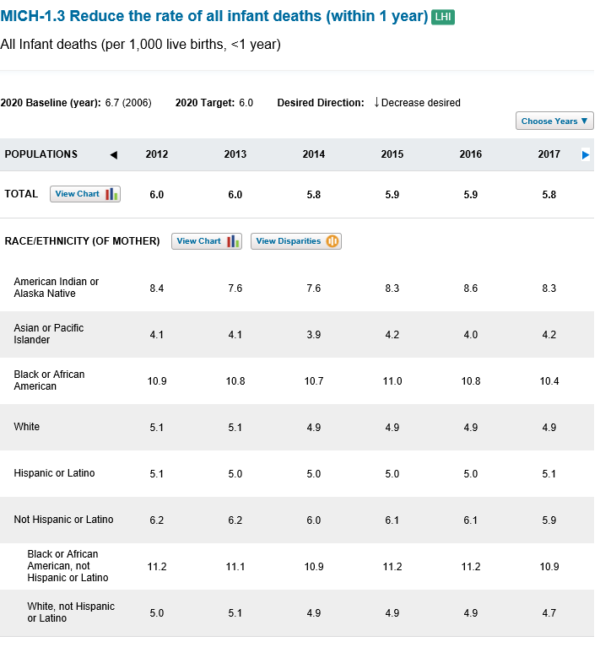
Example (Most Recent)
The difference between the best and worst group rates was 6.7 infant deaths per 1,000 live births (maximal rate difference).
$$10.9−4.2=6.7$$
The worst group rate was 2.576 times the best group rate (maximal rate ratio).
$$\frac{10.9}{4.2}=2.576$$
The average rate for all other race/ethnicity groups (excluding the best) was 1.715 times the best group rate (summary rate ratio).
$$\frac{\frac{8.3+5.1+10.9+4.7}{4}}{4.2}=1.715$$
20

Slide 21
Example (Changes over Time)
The change in maximal rate difference over time was –2.1 infant deaths per 1,000 live births, which means the disparity went down by 2.1 on an absolute scale.
$$6.7−8.8=−2.1$$
The change in maximal rate ratio was –0.358, which means the disparity went down by 0.358 on a relative scale.
$$2.576−2.934=−0.358$$
The change in summary rate ratio was – 0.077, which is a decrease in disparity.
$$1.715−1.792=−0.077$$
Note: For simplicity of presentation, these results do not consider statistical significance of changes over time. This testing should be done whenever measures of variability are available, as outlined in Talih and Huang (2016).
21

Slide 22
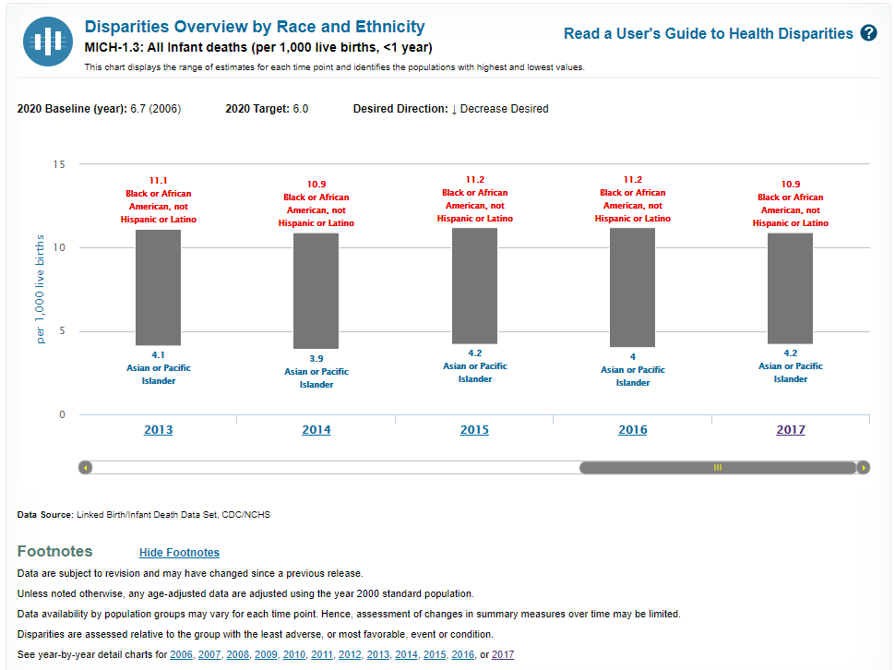
HP2020 Disparities Tool
The best/worst groups and values are always shown in blue/red, respectively, regardless of the desired direction
Users can view footnotes beneath the Overview chart
Users can click individual years to drill down to disparities details
22

Slide 23
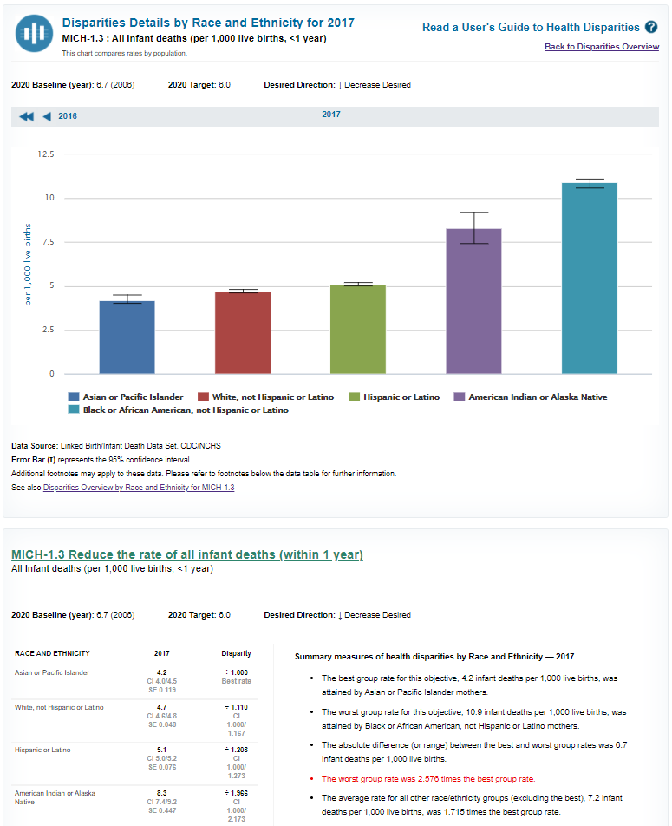
After clicking on a year, a chart displays data for all groups for a particular year
The page also includes a data table and summary disparities text describing measures of health disparity
23

Slide 24
Next Steps

Slide 25
Looking Ahead
Rolling Release of HP2020 Final Review Components Foundation Health Measures Overview of Health Disparities Release of HP2020 Disparities Statistical Note Archive of HP2020 website and database | Charting features Disparities Tool State data and maps HP2030 Webinars Progress Reviews LHI Updates OHM Updates HP2030 Midcourse Review HP2030 Final Review Outreach & Dissemination
25

Slide 26
Disparities-related Resources
Websites:
Healthy People 2020 Disparities Data: https://www.healthypeople.gov/2020/data-search/Search-the-Data#hdisp=1;
Health Disparities Calculator (NCI): https://seer.cancer.gov/hdcalc/
Manuscripts:
Talih M, Huang DT. Measuring progress toward target attainment and the elimination of health disparities in Healthy People 2020. Healthy People Statistical Notes, no 27. Hyattsville, MD: National Center for Health Statistics. 2016. https://www.cdc.gov/nchs/data/statnt/statnt27.pdf
Keppel K, Pamuk E, Lynch J, et al. Methodological issues in measuring health disparities. National Center for Health Statistics. Vital Health Stat 2(141). 2005. https://www.cdc.gov/nchs/data/series/sr_02/sr02_141.pdf
Harper et al. Implicit value judgments in the measurement of health inequalities. Milbank Q. 2010;88(1):4–29. https://doi.org/10.1111/j.1468-0009.2010.00587.x
Braveman P. Health disparities and health equity: concepts and measurement. Annu Rev Public Health. 2006;27:167-194. https://doi.org/10.1146/annurev.publhealth.27.021405.102103
Penman-Aguilar A, Talih M, Huang D, et al. Measurement of health disparities, health inequities, and social determinants of health to support the advancement of health equity. J Public Health Management Practice. 2016; 22(1 Supp):S33-S42. https://doi.org/10.1097/phh.0000000000000373
26

Slide 27
Thank You!
Websites
Healthy People 2030 Site
https://health.gov/healthypeople
NCHS Healthy People Site
http://www.cdc.gov/nchs/healthy_people.htm
NCHS Healthy People Publications
http://www.cdc.gov/nchs/products/hp_pubs.htm

