Slide 1
A Meta-Analysis of the Impact of Number of Contact Attempts on Response Rates and Web Completion Rates in Multimode Surveys
Ting Yan
Westat
November 2, 2021

Slide 2
Multimode surveys
Multimode surveys are on the rise
  Using multiple modes to contact and to collect data from potential respondents
Benefits (de Leeuw 2018; Tourangeau 2017):
  Improving coverage
  Increasing response rates
  Reducing cost
  Improving measurement
COVID-19

Slide 3
This talk
Focuses on multimode surveys using mail and web to collect data from potential respondents
Using a meta-analytic approach to quantifying two benefits (de Leeuw 2018; Tourangeau 2017):
  Improving coverage
  Increasing response rates
    Impact of design features on response rate
  Reducing cost
    Impact of design features on percent of web completes
  Improving measurement

Slide 4
Types of web and mail multimode designs
Concurrent
  Web and mail are offered to respondents at the same time
    HINTS 5 Web Pilot (Westat, 2019): Web option condition
      1st contact: web login + paper questionnaire
      2nd contact: Postcard reminder
      3rd contact: letter reminder with web login + paper questionnaire
      4th contact: letter reminder with web login + paper questionnaire

Slide 5
Types of web and mail multimode designs
Sequential mail and web
  Paper questionnaire is offered first and web is offered later
    Lewiston and Clarkston Quality of Life Survey (Smyth et al. 2010)
      1st contact: pre-notification letter
      2nd contact: paper questionnaire
      3rd contact: postcard reminder
      4th contact: paper questionnaire + web login

Slide 6
Types of web and mail multimode designs
Sequential web and mail
  Web is offered first and paper questionnaire offered later
    2015 VA Survey of Veteran Enrollee’s Health and Use of Health Care (Westat, 2015): Hard-to-interview control condition
      1st contact: pre-notification letter
      2nd contact: invitation letter with web login
      3rd contact: IVR reminder
      4th contact: letter reminder with paper questionnaire
      5th contact: Postcard reminder
      6th contact: letter reminder with paper questionnaire

Slide 7
Impact of design features of multimode surveys
Type of design
Number of contacts
Was a pre-notification letter sent?
Was incentive offered?
Was email used to reach sampled persons?
Timing of the second mode

Slide 8
Meta-analysis
Searched for experimental studies that varied design features
  Key words: multimode, mixed mode, multiple modes of data collection, web, mail, paper, sequential, concurrent, choice, push-to-web
Reviewed studies for eligibility
  Has to be empirical studies
  Has to include experiments
  Has to include sufficient information on design features, sample size, response rate, number of web completes or percent of web completes
Retained 29 papers for coding
  38 studies
  113 estimates

Slide 9
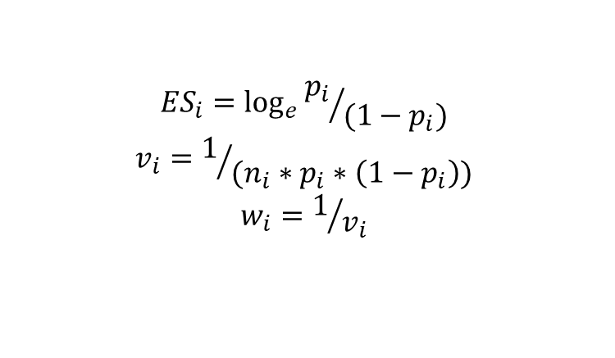
Meta-analysis (2)
For each eligible study,
  Coded design features (e.g., type of multimode design etc)
  Entered or manually calculated
    Response rate
    Percent of interviews completed on web
  Calculated effect size (and variance)
    Logit transformation of response rate and web completion rate
$${ES}_{i}=\log_{e}{{p_{i}}/{(1−p_{i})}}$$
$$v_{i}=1/{(n_{i}∗p_{i}∗\left(1−p_{i}\right))}$$
$$w_{i}=1/{v_{i}}$$

Slide 10
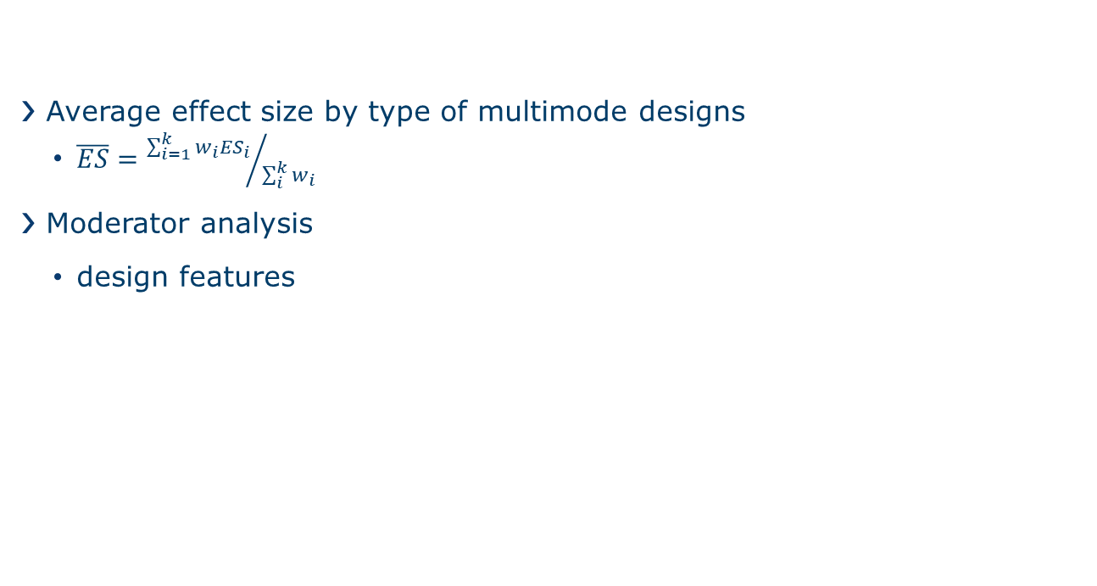
Meta-analysis (3)
Average effect size by type of multimode designs
  $\overline{ES}={\sum_{i=1}^{k}{{w_{i}ES}_{i}}}/{\sum_{i}^{k}{w_{i}}}$
Moderator analysis
  design features

Slide 11
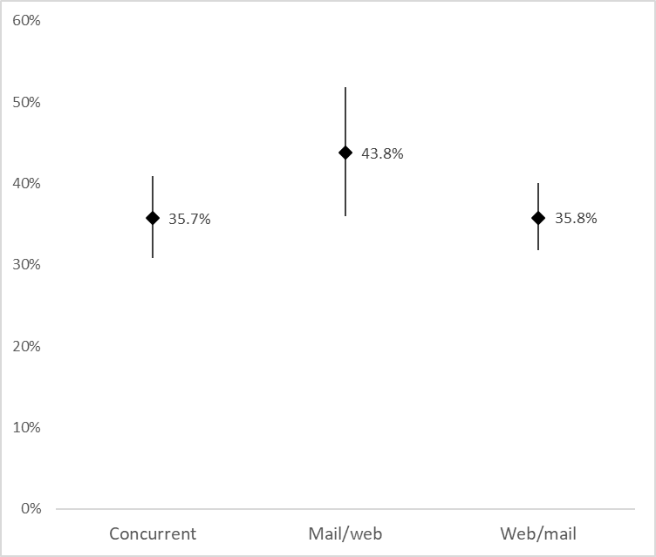
Results: Response rates by type of multimode designs
Concurrent mail/web designs:
  28 effect sizes nested in 17 studies nested in 14 papers
Sequential mail/web:
  15 effect sizes nested in 11 studies nested in 10 papers
Sequential web/mail:
  70 effect sizes nested in 34 studies nested in 26 papers

Slide 12
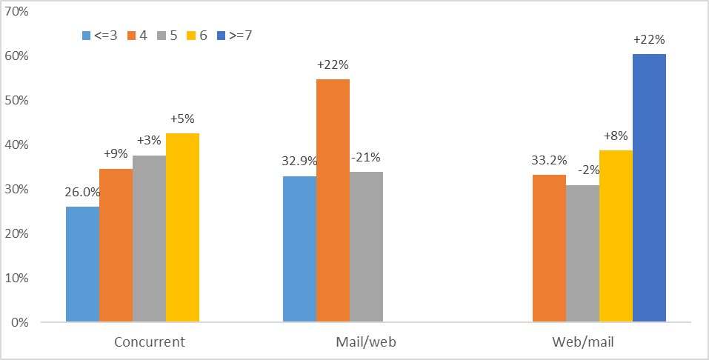
Results: Response rates by number of contacts
Ranging from 2 to 17
Mode number of contacts
  Concurrent: 5
  Mail/web: 4
  Web/Mail: 4
Overall effect
  0.12 (p<.0001)

Slide 13
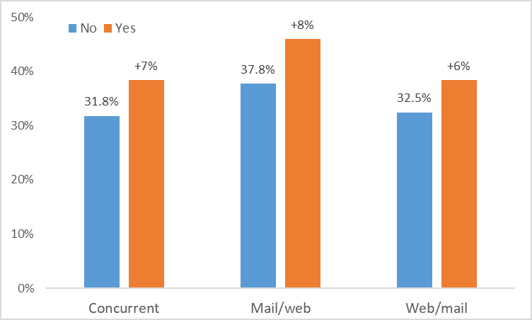
Results: Response rates by pre-notification letter
% sent a pre-notification letter:
  Concurrent: 61%
  Mail/web: 73%
  Web/Mail: 57%
Overall effect
  0.29 (p<.05)
Notes:
Difference 6.6% 8.2% 7.3%

Slide 14
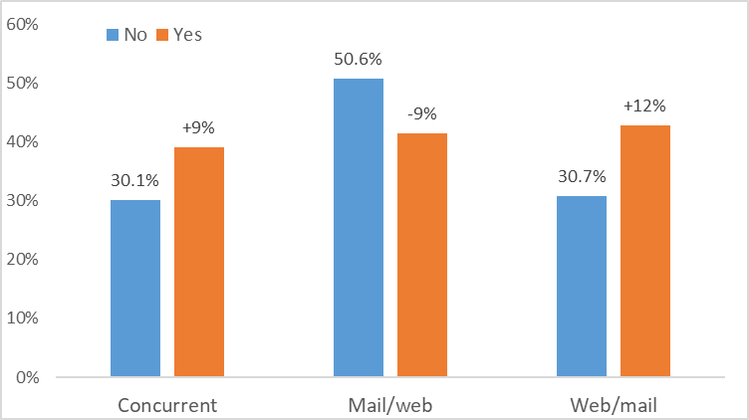
Results: Response rates by incentive
% offered incentive
  Concurrent: 64%
  Mail/web: 73%
  Web/Mail: 44%
Overall effect
  0.41 (p=.002)
Notes:
Difference 6.6% 8.2% 7.3%

Slide 15
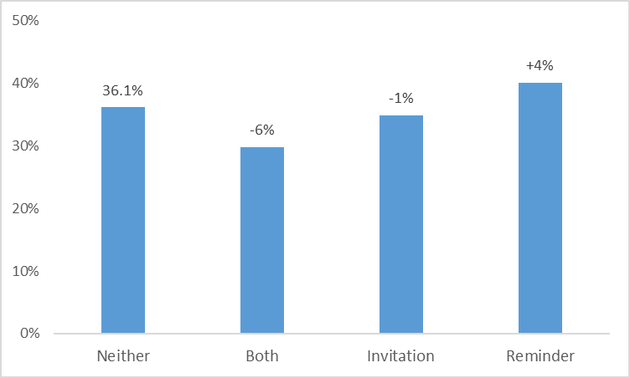
Results: Response rates by use of email
Email use
  Concurrent: 1 study used email reminder
  Mail/web: 1 study sent web survey via email
  Web/Mail:
    7%: email invitation
    14%: email reminder
    11%: both
    66%: did not use email

Slide 16
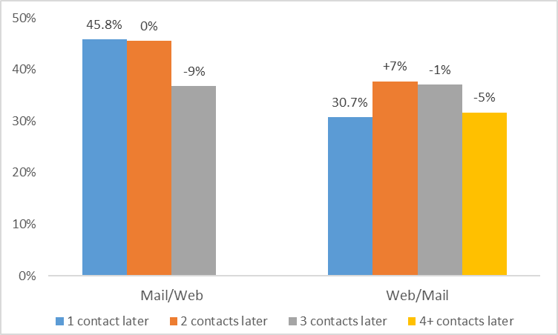
Results: Response rates by timing of second mode
Most studies offered 2nd mode 2 contacts after 1st mode

Slide 17
Summary of findings on Response Rate
Design Feature | Impact on Response Rate
Type of design | mail/web > (concurrent = web/mail)
Number of contacts
Pre-notification
Incentive | concurrent and web/mail: mail/web:
Email (web/mail only) | Email reminder:
Timing of 2nd mode | mail/web: higher RR when offering 2nd mode 1 or 2 contacts later web/mail: higher RR when offering 2nd mode 2 or 3 contacts later

Slide 18
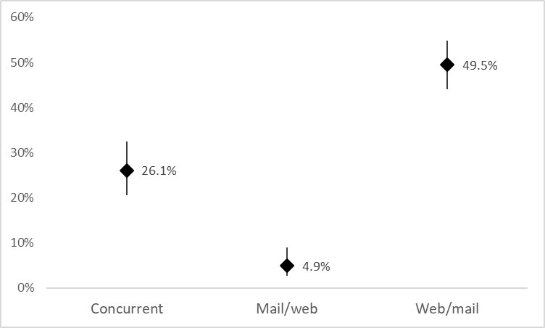
Results: Web completion rates by type of design

Slide 19
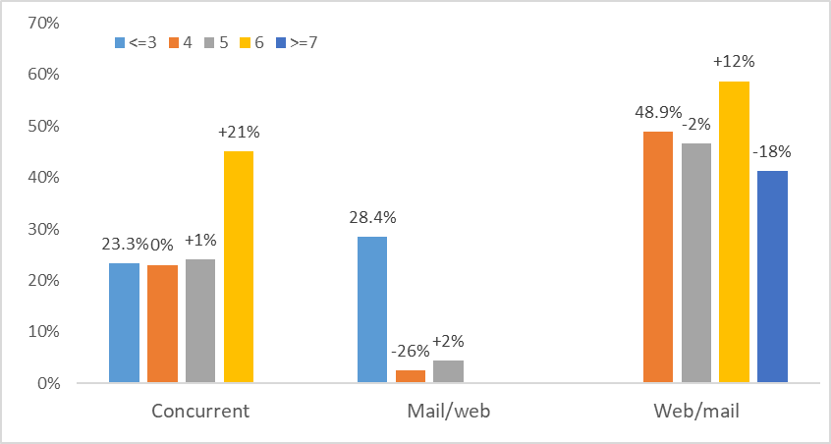
Results: Web completion rates by number of contacts

Slide 20
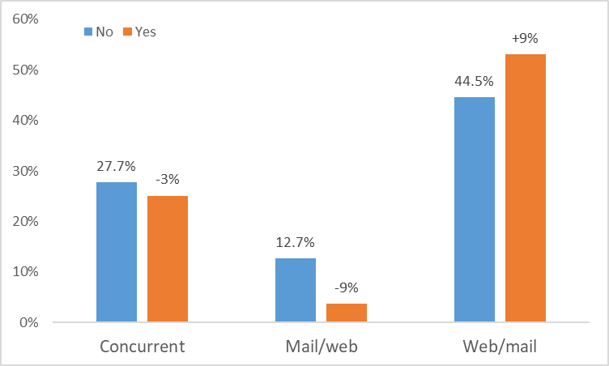
Results: Web completion rates by Pre-notification

Slide 21
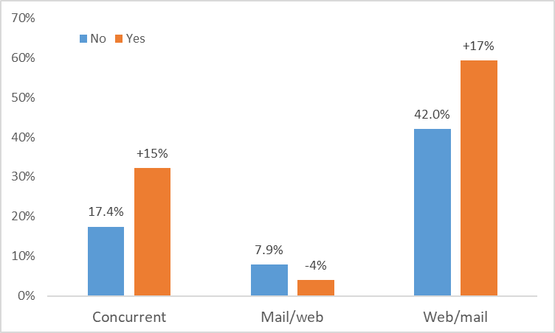
Results: Web completion rates by Incentive

Slide 22
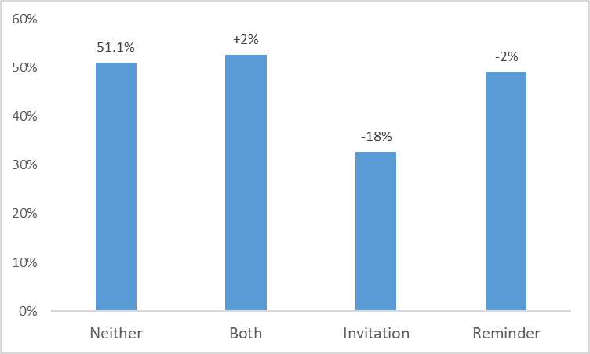
Results: Web completion rates by use of email
(Sequential web/mail only)

Slide 23
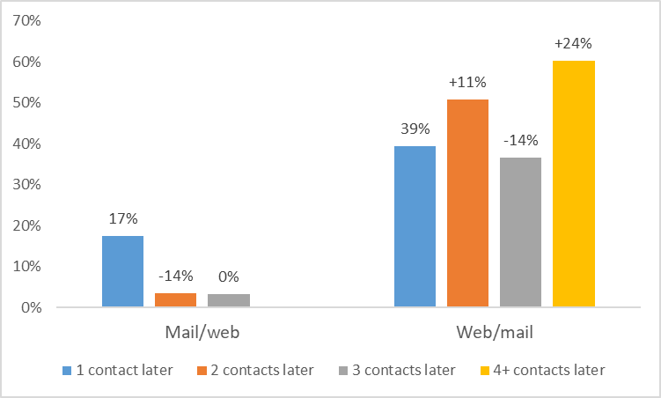
Results: Web completion rates by timing of second mode

Slide 24
Summary of findings on web completion rate
Design Feature | Impact on web completion rate
Type of design | web/mail > concurrent > mail/web
Number of contacts | concurrent and web/mail:
Pre-notification | concurrent and mail/web: web/mail:
Incentive | concurrent and web/mail: mail/web:
Email (web/mail only) | Email invitation+ email reminder:
Timing of 2nd mode | mail/web: higher WCR when offering 2nd mode 1 contact later web/mail: higher WCR when offering 2nd mode 2 or 4+ contacts later

Slide 25
Recommended sequence
If goal is to maximize response rate
  Concurrent: 6 contacts, pre-notification, incentive,
  Mail/web: 4 contacts, pre-notification, no incentive, offering web at 3rd contact
  Web/mail:7+ contacts, pre-notification, incentive, offering mail at 4th contact, email reminder
If goal is maximize web completion rate
  Concurrent: 6 contacts, no pre-notification, incentive
  Mail/web: 3 contacts, no pre-notification, no incentive, offering web at 2nd contact
  Web/mail: 6 contacts, pre-notification, incentive, offering mail at 6th contact, email invitation+email reminder

Slide 26
Limitations and Future Research
Only examined a few selected moderators
  Future research should examine other moderators such as target population, type of sampling frame, type and amount of incentives, survey topic
Only examined one moderator at a time
  Future research could employ a meta-regression approach to examine the impact of all moderators at the same time
Limited to studies involving an experiment
  Future research could expand to include empirical studies that do not include an experiment

Slide 27
Thank You
tingyan@Westat.com
*A big thank-you to Alexis Kokoska and Winnie Xu for their help with coding

