Slide 1
Applying Client Relationship Management Techniques to an Institutional Contacting Guide Redesign
Federal Committee on Statistical Methodology Conference 2021
Presenter: Rob McCracken
RTI International

Slide 2


Contributors
Agency for Healthcare Research and Quality:
Peter Tice
RTI International:
Shawn Cheek
Jason Kennedy
Rob McCracken (presenter)
Joe Nofziger
Brandon Peele
R. Suresh

Slide 3

Overview
Project Description
Contacting Medical Providers / Pharmacies
Contact Guide Redesign & Client Relationship Management
Contact Guide Redesign and Goals
  Goal 1: Improve Effectiveness Through More Focus on POCs
  Goal 2: Improve Flow at Key Points
  Goal 3: Update Instrument to Windows Application Platform
Results

Slide 4

Project Description
The Medical Expenditure Panel Survey, conducted by the Agency for Healthcare Research and Quality (AHRQ), is a family of large-scale federal surveys used to study healthcare costs and related healthcare measures.
The MEPS HC collects information on approximately 14,000 households annually though multiple rounds of in-person interviews.
The MEPS Medical Provider Component (MPC) is a follow-back survey of providers, designed to collect more information on healthcare spending than the MEPS-HC respondents can typically provide with precision.

Slide 5
Project Description (cont.)
The MPC sample members are the healthcare providers identified in the Household Component (HC).
The MEPS MPC obtains medical and billing records from medical providers and pharmacies to inform the cost of medical procedures and ascertain expenditure information.
RTI International (RTI) has been supporting AHRQ in conducting the MEPS-MPC since 2009.

Slide 6
Contacting Medical Providers / Pharmacies
MEPS MPC collects medical and billing information from provider/pharmacy points of contact (POCs) for selected patients
  Hospital providers require multiple POCs
  Each Hospital POC provides records
  Tracking best done at POC level (not provider level)
Data collected over the phone or from records received by fax, mail or web portal

Slide 7

Contacting Medical Providers / Pharmacies (cont.)
Two instruments / processes
  Contact Guide
    Establish provider eligibility
    Identify & establish POC
    Gather POC contact info
    Verify providers
    Send authorization forms (AFs)
    Confirm AFs
    Prompt for overdue records
  Event Form
    Collect billing and payment data

Slide 8
Contact Guide Redesign & Client Relationship Management
Rethinking the MEPS MPC “client” with CRM
Original Contact Guide
“Client” thought of as provider
Only 1 POC can be primary
Provider verified with 1 POC
Records tracked by provider
Redesigned Contact Guide
Client thought of as POC
Multiple primary POCs allowed
Provider verified with each POC
Records tracked by POC

Slide 9
Contact Guide Redesign and Goals
  Improve effectiveness for data collectors and POCs through more focus on POCs.
  Improve flow at key points to increase efficiency and reduce errors.
  Build a more robust system by upgrading the instrument from a web-based platform to a Microsoft Windows (Dot Net) Application platform.

Slide 10
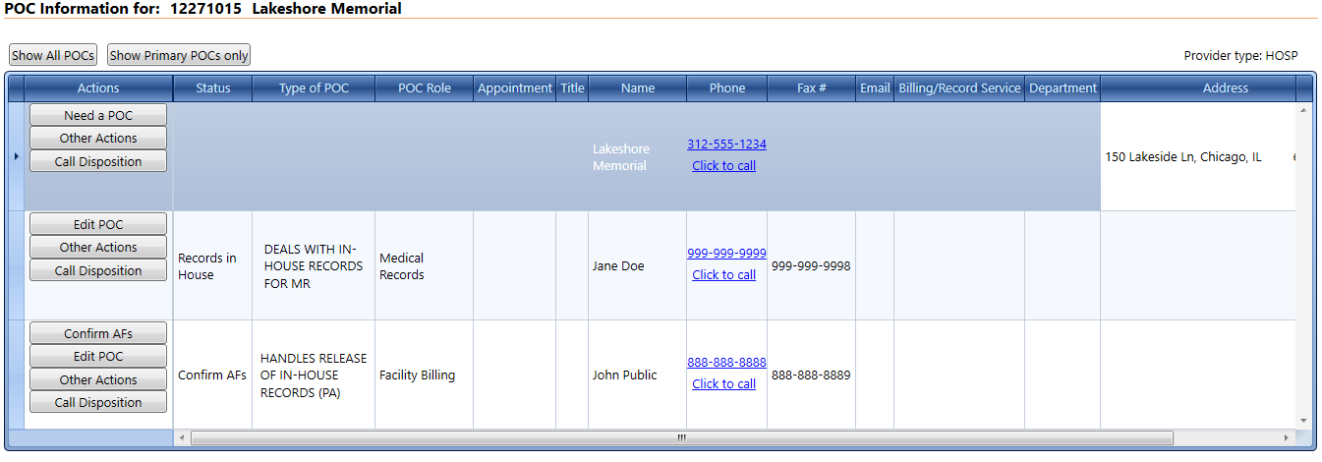
Goal 1: Improve Effectiveness Through More Focus on POCs
POC-based focus instead of provider-based focus
Status of records tracked at POC level instead of provider
Faster/easier identification of next step needed per POC

Slide 11
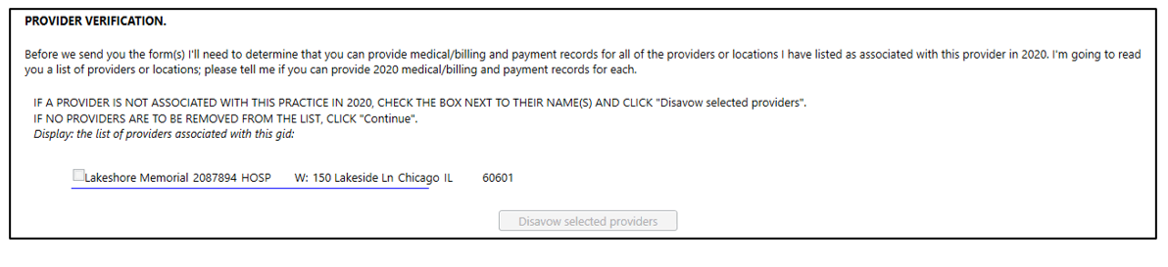
Goal 1: Improve Effectiveness Through More Focus on POCs
Provider Verification
  Hospitals typically have 2 POCs – Medical Records and Billing
  Provider Verification item confirms POC handles provider’s records
Original Contact Guide: Verified one time per provider
Redesigned Contact Guide: Verified with each POC

Slide 12
Goal 2: Improve Flow at Key Points
Original System – first call to POC
Completed within Contact Guide Completed in External Component
Establish provider eligibility
Identify & establish POC
Gather POC contact info
Verify providers
Send authorization forms

Slide 13
Goal 2: Improve Flow at Key Points (cont.)
Redesigned System – first call to POC
Completed within Contact Guide
Establish provider eligibility
Identify & establish POC
Gather POC contact info
Verify providers
Send authorization forms

Slide 14
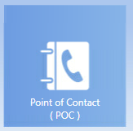
Goal 3: Update Instrument to Windows Application Platform
Both original and update operate in FIPS moderate environment
New system more robust
New system easier to troubleshoot
Notes:
that part of troubleshooting.

Slide 15

Results
February 2020 start
Difficulties comparing pre-pandemic outcomes (data collected) to current outcomes
Mixed anecdotal feedback from data collectors

Slide 16

Questions?
Contact: Rob McCracken | email: mccracken@rti.org

Slide 17

Thank you
Contact: Rob McCracken | email: mccracken@rti.org

